Slide 1
Research & Innovation in transformation: a transition towards Open Science
Jean-François Dechamp
European Commission, Directorate-General for Research & Innovation
9th UNICA Scholarly Communication Seminar
14 October 2019, Vilnius University, Lithuania

Slide 2
The European Commission in the R&I context
A policy maker
It proposes EU legislation and monitors its implementation
It works with the European Legislator (European Parliament and Council)
It invites Member States to act
A funder
It sets its own rules for EC-funded scientific research and innovation
A capacity builder
It has research facilities (Joint Research Centre) and funds infrastructure that support EC/EU policy

Slide 3
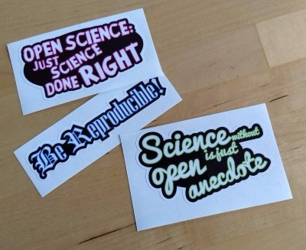
How to describe Open Science?
Many definitions e.g.
‘Open science refers to a new approach to the scientific process based on cooperative work and new ways of disseminating knowledge, improving accessibility to and re-usability of research outputs by using digital technologies and new collaborative tools.’ (source)
Or maybe is it… Just science done right?
Source: Melanie Himming

Slide 4
How do we understand openness?
Openness as: connecting people and ideas
Openness between scientists, between disciplines and communities, between countries, between science and society
It turns R&I into more inclusive activities, involving a broader range of individuals and stakeholders
Openness as: aligning incentives and practices in the R&I system
This comes with rights, obligations and values

Slide 5
Why is Open Science important to us?
It is good for science: efficiency, verifiability, reproducibility, transparency, inter-disciplinarity
It is good for the economy: access to and re-use of scientific information by industry, innovation
It is good for society: broader, faster, transparent & equal access for citizens, increased societal impact of science and research
Most importantly: Open Science is irreversible and is not happening in isolation

Slide 6
Open Science in political agendas
A growing number of EU Member States put openness in the core of their vision, plans or activities for R&I
As research librarians, be a part of it!
Openness is at the core of the EU policy for science
We do not want some of EU Member States or European regions to be left behind
We want to reinforce the standing of all our universities, research centres and innovative companies
Open Science does not work in isolation
It needs international collaboration

Slide 7
Open Science and EU Member States
In short: your country agreed with moving forward with Open Science
Council conclusions on open, data-intensive and networked research as a driver for faster and wider innovation (2015)
Council conclusions on the transition towards an Open Science system (2016)
Council conclusions on accelerating knowledge circulation in the EU (2018)
ERAC WG recommendations on open science (2018)
ERAC WG opinion on open innovation (2019)

Slide 8
Open Science in the EU legislation
In short: your country modifies its legislation
Revision of the Recommendations on access to and preservation of scientific information (2018): sets the landscape for OS with a view to tackle disparities and also covers infrastructure, metrics, rewards, skills…
Revision of the EU Copyright Directive (2018): provides for an exception for research organisations to carry out TDM
Revision of the Open data and the re-use of public sector information Directive (2018): asks Member States to develop OA policies for research data and that commercial and non-commercial re-use must be allowed for research data that is publicly available in repositories; it also enshrines ‘As open as possible, as closed as necessary’

Slide 9
8 policy priorities for Open Science
Use and management of research results
1. FAIR data: FAIR data sharing is the default for funding scientific research
2. European Open Science Cloud: all EU researchers are able to deposit, access and analyse European scientific data through EOSC, without leaving their desk
3. Indicators: alternative metrics (next generation metrics) complement conventional indicators for research quality and impact (e.g. JIF and citations)
4. Future of scholarly communication: all peer reviewed scientific publications are freely accessible and early sharing of different kinds of research outputs is encouraged
Alignment of research partners
5. Rewards and incentives: the European research career evaluation system fully acknowledges Open Science activities
6. Research Integrity: all publicly funded research in the EU adheres to commonly agreed Open Science standards of research integrity
7. Skills and education: all scientists in Europe have the necessary skills and support to apply Open Science research routines and practices
8. Citizen Science: citizens significantly contribute and are recognised as valid knowledge producers of science
Pointer: Amsterdam Call for Action on OS (policy priorities identified from 12 action items)

Slide 10
The evolution of the EU funding programmes for R&I
2021
FP7
OA Pilot
Deposit and open access
Horizon 2020
OA Mandatory
Deposit and open access
& ORD/DMP Pilot
Horizon 2020
OA Mandatory
Deposit and open access
& ORD/DMP by default
(opt-out)
2017
Horizon Europe
OA Mandatory
Deposit and open access
DMP in line with FAIR Mandatory
ORD by default (exceptions)
& Open Science embedded
2014
2008

Slide 11
Open Science in Horizon Europe
Following common understanding (March 2019), provisions on open science to be discussed with Member States early 2020
Go beyond open access to publications & data
Clarify and strengthen OA obligations (e.g. Plan S)
Set obligations towards FAIR and open data sharing, and data management, while complying with IPR rules and exploitation obligations
Encourage OA to other research output
Stick to the principle ‘As open as possible, as closed as necessary’

Slide 12
Possible scenario for incorporation of Plan S principles in Horizon Europe
Open access via repositories (also when OA publishing) kept but made immediate
Embargoes not accepted any longer
Copyright retention and open license asked for
Copyright retention already in the HE Regulation
Open license to be required (in line with new standard licence adopted by the EC for its own information production)
Publication in hybrid journals allowed
However, costs may not be eligible

Slide 13
Proposals for research data in Horizon Europe
Mandatory Data Management Plan
When there is research data generated, collected, re-used…
Open by default
Unless it cannot be (exceptions should apply)
Open access/data management disambiguated
Different from current situation in Horizon 2020
FAIR research data
Identifiers, trusted repositories, machine-readable licences among other requirements
Use of European Open Science Cloud
For consideration in some Work Programmes

Slide 14
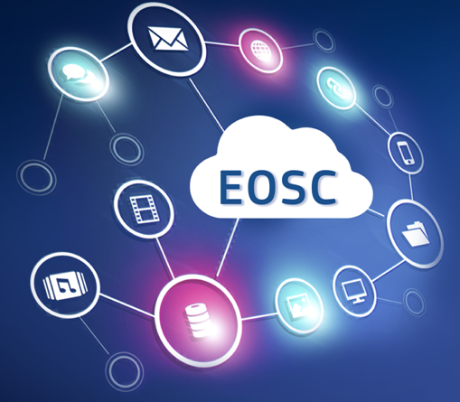
European Open Science Cloud
A trusted and open virtual environment for the scientific community with seamless access to services addressing the whole research data life cycle (link)
Federating core services
Services to make data FAIR, store them and ensure long-term preservation
Services to find, access, combine, analyse and process data
Protected, personalized work environment

Slide 15
Open Research Europe
The future European Commission’s publishing platform
Aim: offer Horizon 2020 beneficiaries a free and fast publication possibility for peer reviewed articles & pre-prints
Plus: improve uptake of OA in H2020 (and Horizon Europe)
Public procurement closed on 9 September 2019 (second call)
Tenderers have been called to customize an existing publishing infrastructure solution to the requirements of the European Commission, to develop processes and policies to run the platform as a service, to engage in communication activities for the platform and to run the service and publish articles in the platform.
The tender is for a framework contract with a duration of 4 years.

Slide 16
Personal thoughts
Overall aim
kick-starting a virtuous circle and change of culture
Issues
Explanation: paramount
Tools and support: needed
Money: both a bad and a good excuse
Feedback: important
Monitoring: complex (see Open Science Monitor and Horizon Dashboard)
Incentives and reward: the key?

Slide 17
Issues to watch
Apart from a new European Commission…
… and the ‘B word’!
Legal and regulatory issues in your own country
Implementation of Copyright Directive (for Text and Data Mining), Database Directive, Public Sector Initiative (PSI) Directive
Evolution of the scholarly communication sector
Alternative publishing solutions, publishers’ agreements ('offsetting deals‘) etc.
Evolution of FAIR data
Findable, Accessible, Interoperable and Re-usable
Skills
Access to professional training to develop appropriate skills to fully engage with open science (e.g. research data management)
Metrics and indicators adapted to Open Science
Incentives, acknowledgment and reward are key in a professional career
Adapt the rewarding mechanisms to researchers for their sharing

Slide 18
Thank you!
With Open Science, we want to give European researchers and innovators the best conditions to do their job.
Mail: RTD-open-access@ec.europa.eu
Web: ec.europa.eu/research/openscience/
This work is licensed under a Creative Commons Attribution 4.0 International License and illustrations are in the public domain (otherwise the origin is mentioned)

