Slide 1
UNICA EduLAB - King’s College London joint Conference
An Emerging Model of College Students learning? China’s experience on AI-assisted learning
Mei Li
Institute of Higher Education, East China Normal University, China
mli@ses.ecnu.edu.cn
19-20 May 2025

Slide 2
OUTLINE
Brief introduction to research on AIED
China’s experience on application of AI in learning
Challenges, Risks, Reflection on application of AI

Slide 3
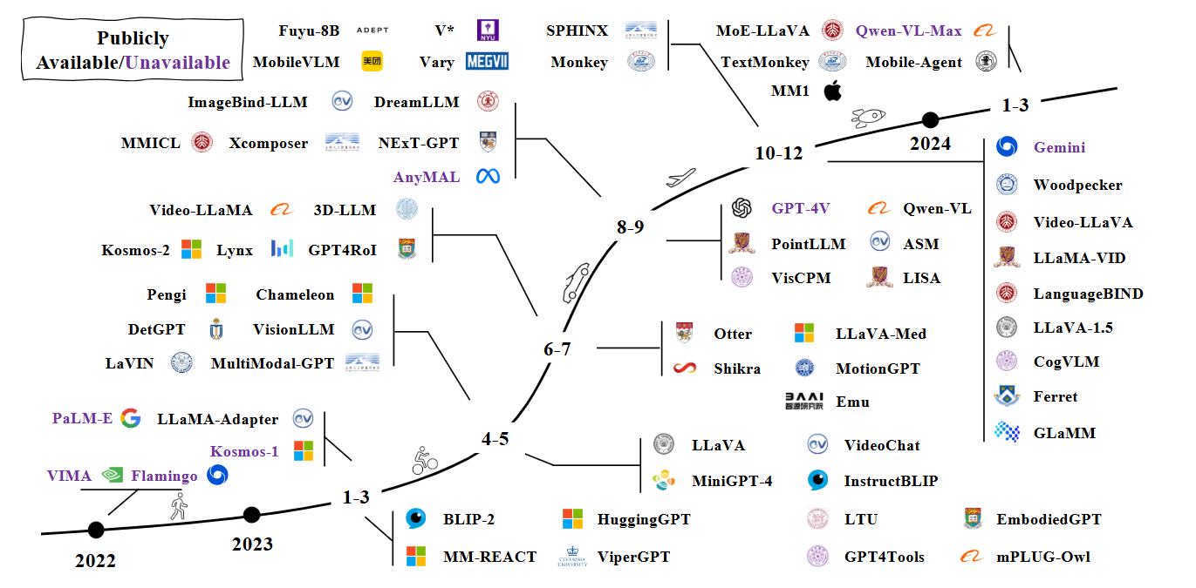
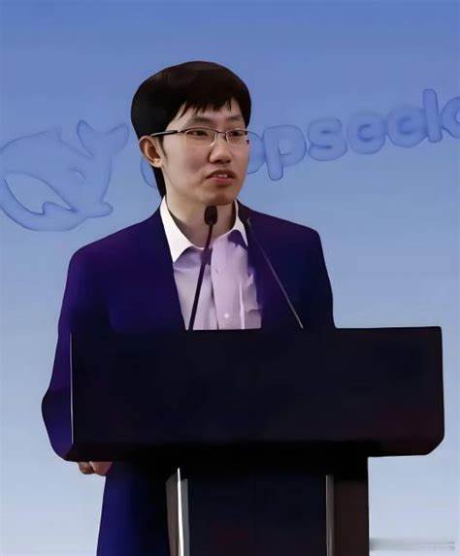
AI has transformed teaching and learning fundamentally.
Are we well prepared?
DeepSeek
2025.1
Generative Artificial Intelligence Application Development Report (2024)

Slide 4
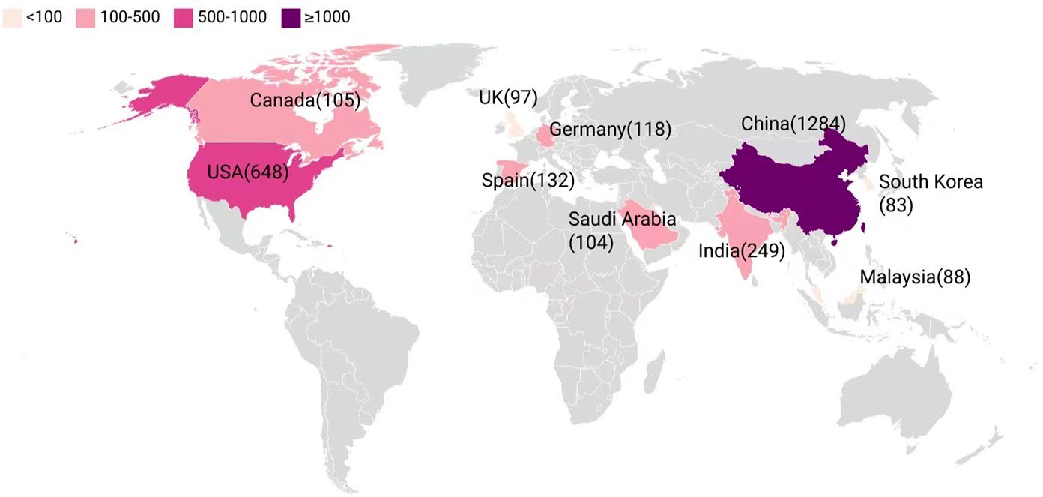
Which country takes the lead:
Top 10 contributed countries in AIED research
6843 publications from Web of Science and Scopus
Shuchen Guo et al.(2024), Artificial intelligence in education research during 2013-2023: A review based on bibliometric analysis. Education and Information Technologies. 29:16387–16409

Slide 5
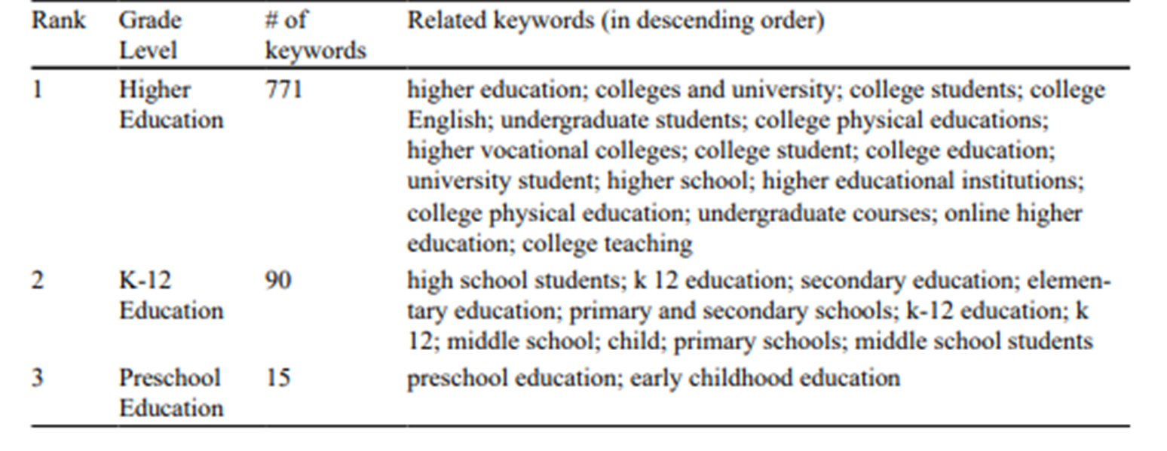
)
More Research focused on Higher Education, Why?

Slide 6
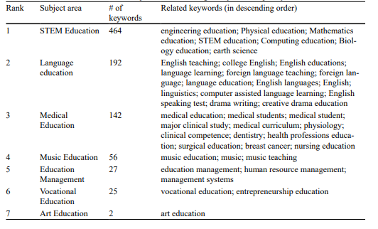
Distribution of subject areas according to keyword frequency
Why English?

Slide 7
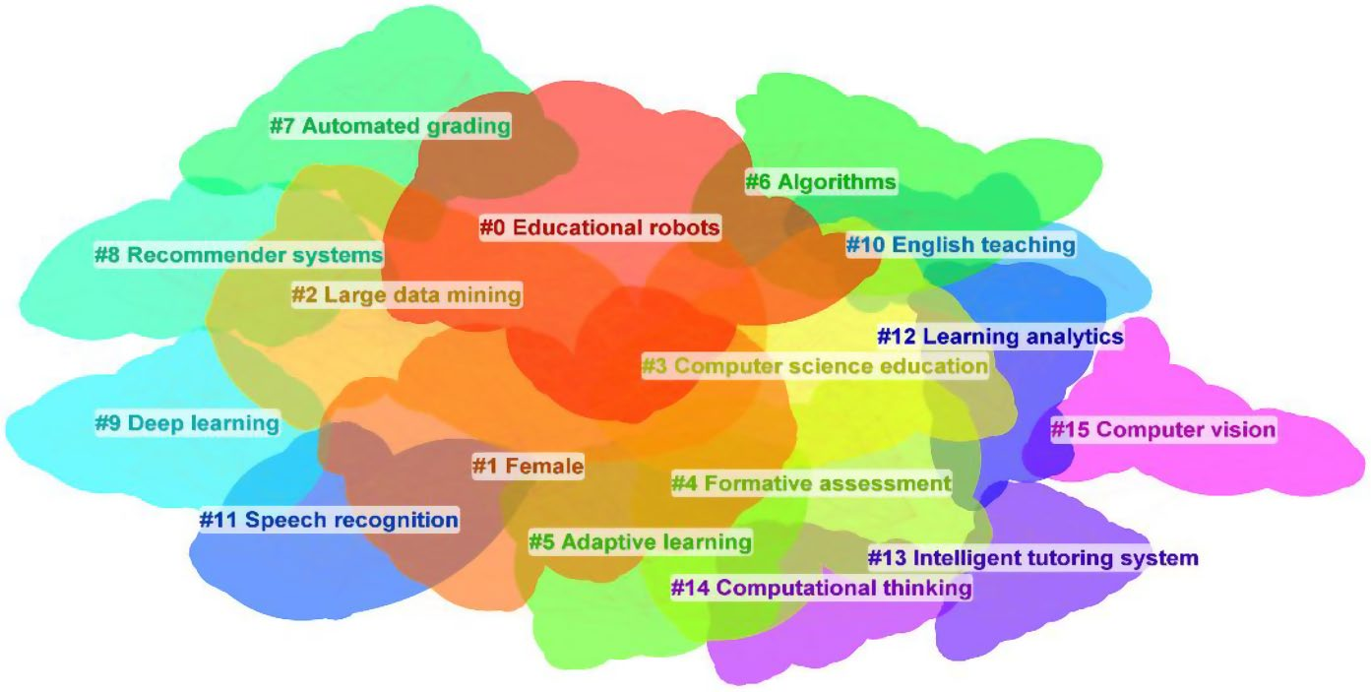
Keyword Clustering Mapping

Slide 8
China:
National and Local governments take active policies and actions
to support the Application of AI in Education
Beijing Guide for the Application of Artificial Intelligence in Education (2024)
Key application areas for AI in education
Intelligent Teaching Assistance
Personalized Learning Support
Smart Educational Assessment
Educational Administration Optimization
Campus Safety and Security
Support for Special Education
Digital Resource Development
Teacher Professional Development
https://www.smartedu.cn/

Slide 9
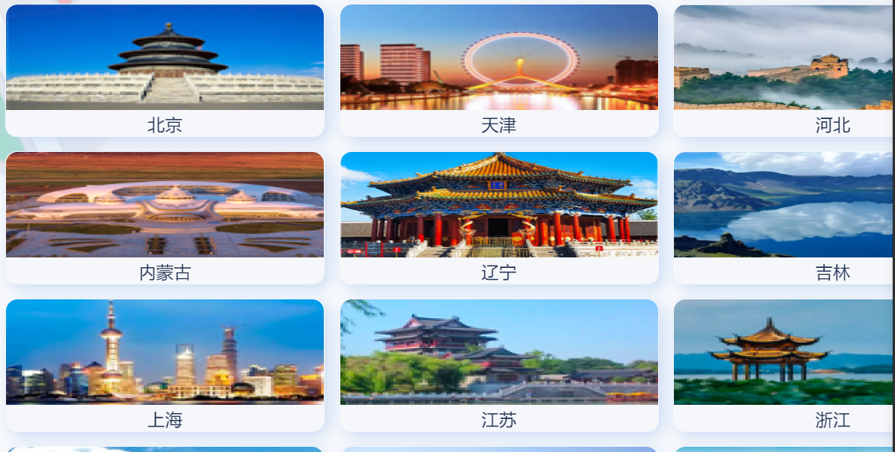
32 Provinces have established resource centers and platforms of smart education

Slide 10
Practice of AI Application at University and Individual levels
Li Yan et al. 2024:
A Survey in Nov. 2023
Participants: 1190 Undergraduates at Zhejiang University
Frequency of Using Gen AI

Slide 11
Tools Used for Generative AI (Multiple - choice) | ChatGPT | 993(Frequency) | 83.45%
 | New Bing | 363 | 30.50%
 | Wenxin Yiyan | 437 | 36.72%
 | Xunfei Xinghuo | 116 | 9.75%
 | ChatGLM | 42 | 3.53%
 | Gamma | 37 | 3.11%
 | Notion AI | 88 | 7.39%
 | Others | 84 | 7.06%
 | Not Filled | 92 | 7.73%

Slide 12
Most Commonly Used Functions of Generative AI (Ranking) | Text Generation | 514(Frequency) | 43.19%
 | Information Search | 439 | 36.89%
 | Language Translation | 58 | 4.87%
 | Conversation Interaction | 51 | 4.29%
 | Grammar Check | 26 | 2.18%
 | Code Debugging | 30 | 2.52%
 | Never Used | 68 | 5.71%
 | Other(s) | 4 | 0.34%

Slide 13
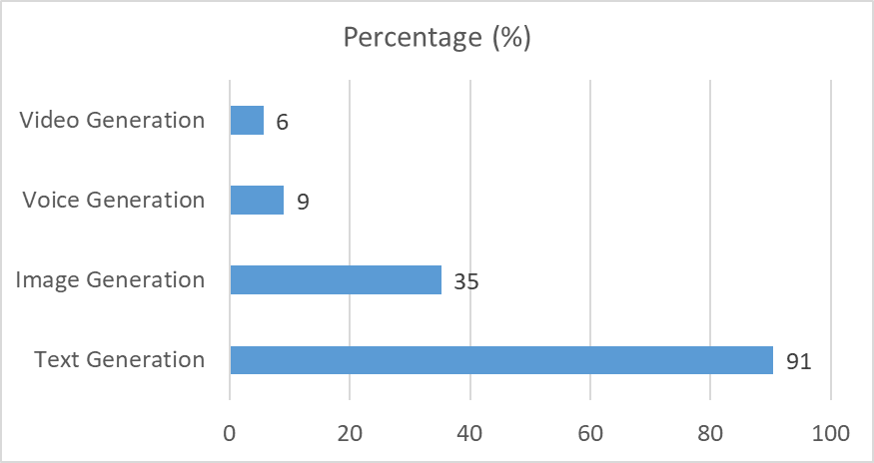
A Survey of College students 'use of GenAI in Zhejiang University
N=1190
Technologies Used for Generative AI (Multiple - choice)
N=1190

Slide 14
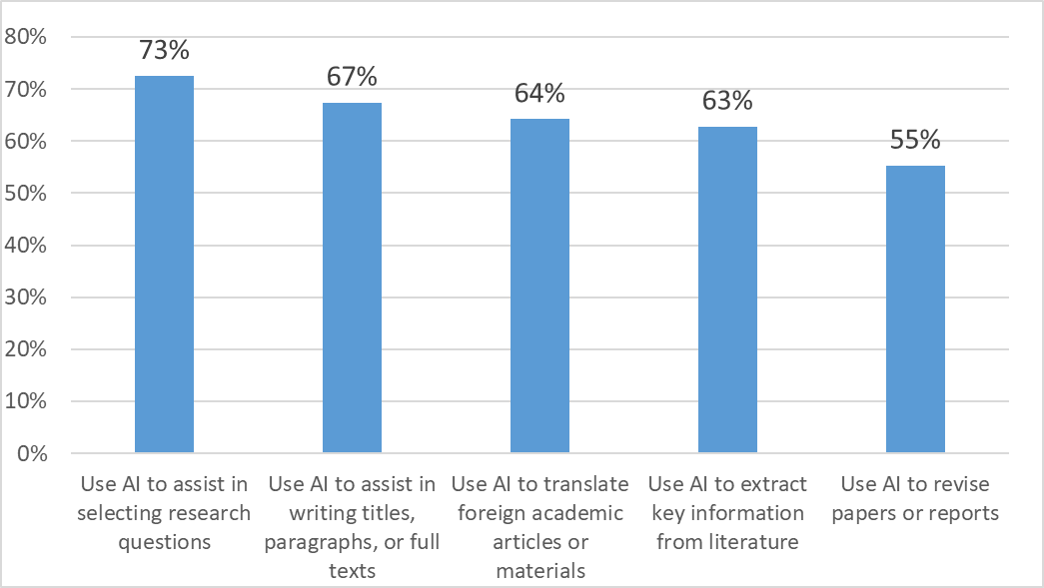
The research activities scenario

Slide 15
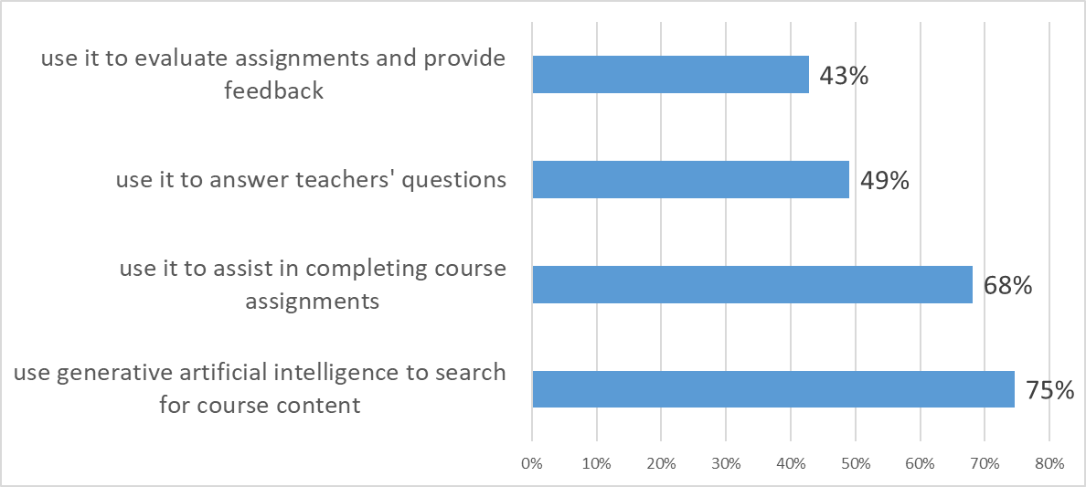
The course learning scenario

Slide 16
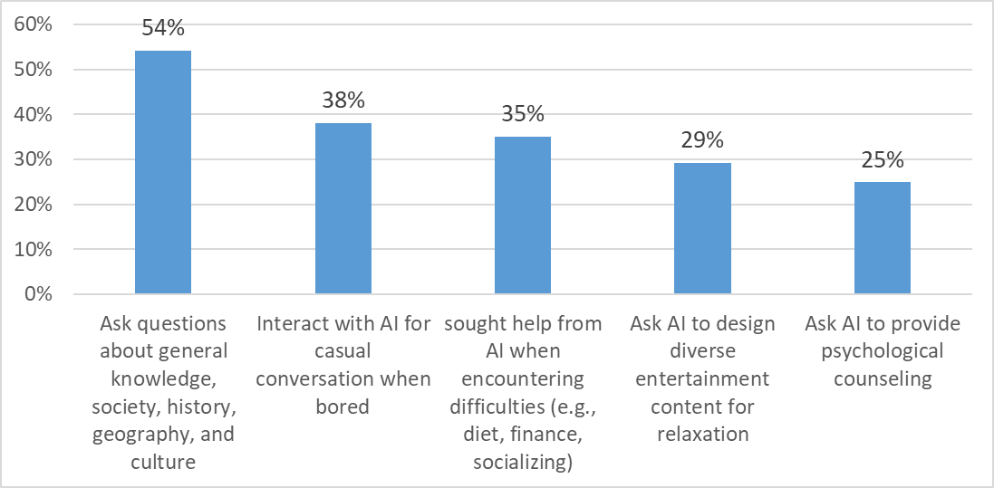
The daily life scenario

Slide 17
Suggestions of College Students on the Use of Generative Artificial Intelligence (n = 310)
Coding Dimension | Frequency | Examples
Offer Courses/Lectures Related to Generative AI | 120 | Student A: Suggest adding courses on skills of using generative AI. Student B: Offer lectures on how to use generative AI efficiently.
Prevent Abuse and Regulate the Use of Generative AI | 57 | Student C: Suggest adopting generative AI dialectically and not abusing it. Student D: Allow the use of generative AI, but students need to mark it so that teachers can understand which content comes from generative AI.
Provide Channels for Using Generative AI | 50 | Student E: Provide free generative AI tools. Student F: Hope to use generative AI through official channels.
Promote the Use of Generative AI | 43 | Student G: The school should promote the use of generative AI.
Improve the Functions of Generative AI | 25 | Student H: Make the answers of generative AI more human - like.
Pay Attention to Plagiarism, Academic Misconduct | 17 | Student I: Optimize the anti - plagiarism mechanism and strictly prohibit large - scale plagiarism.
Develop Personalized Generative AI Tools | 17 | Student J: Suggest that the college train its own generative AI and open it to the research needs on campus.
Reduce Low - quality and Repetitive Assignments | 16 | Student K: Reduce mechanical and formalized assignments.

Slide 18
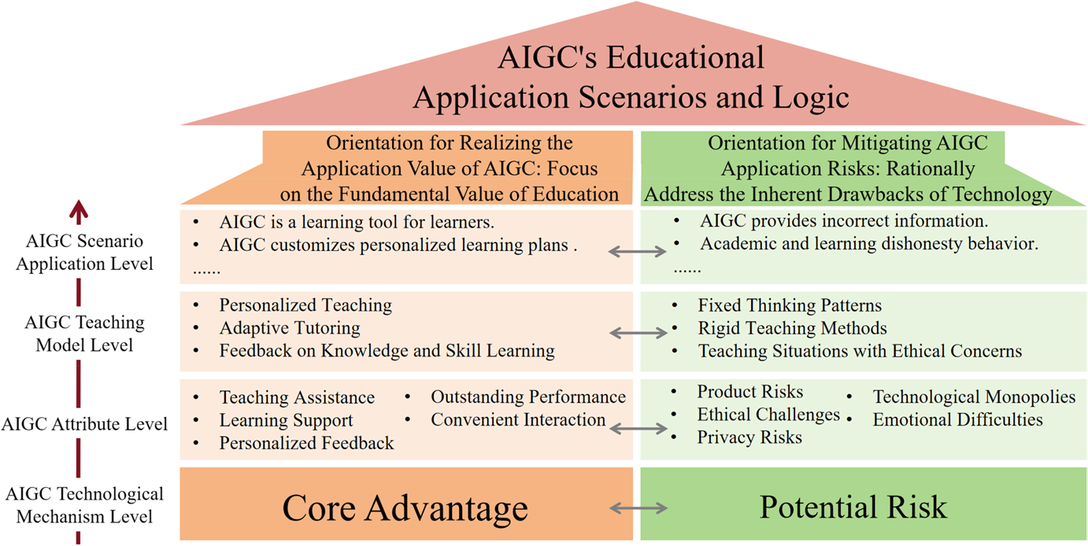
The Underlying Mechanism and Logical Framework of AIGC’s Educational Application
Xiaojiao Chen et al. (2024). Empowering education development through AIGC: A systematic literature review. Education and Information Technologies (2024) 29:17485–17537

Slide 19
Challenges and Risks
Empowerment or Disempowerment? Co-existence or Conflict of Machine and Human? Technology as agent? Autonomy?
Lack of Institutional guidance and regulations on the use of AIED
Teachers’ AI literacy and capability of application AI, Teachers’ role transformation
Generation gap on AI literacy between teachers and students
Negative impact of misuse and over rely on Using AI in learning, Digital Divide: Cheating, academic Integrity, critical thinking, give up deep and high order thinking opportunities, mental health.
Will AI replaces human people?
…

Slide 20
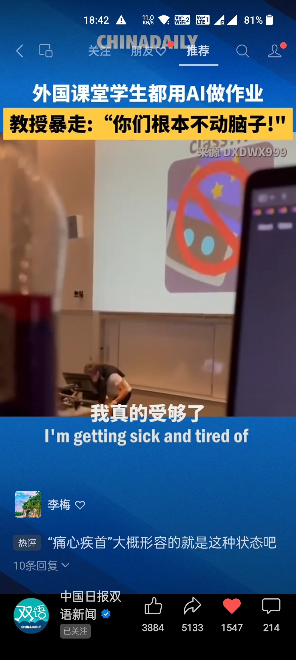
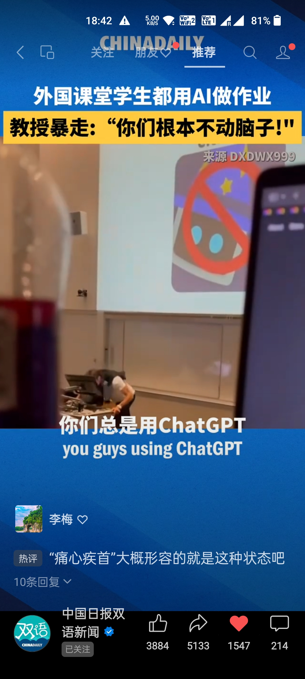
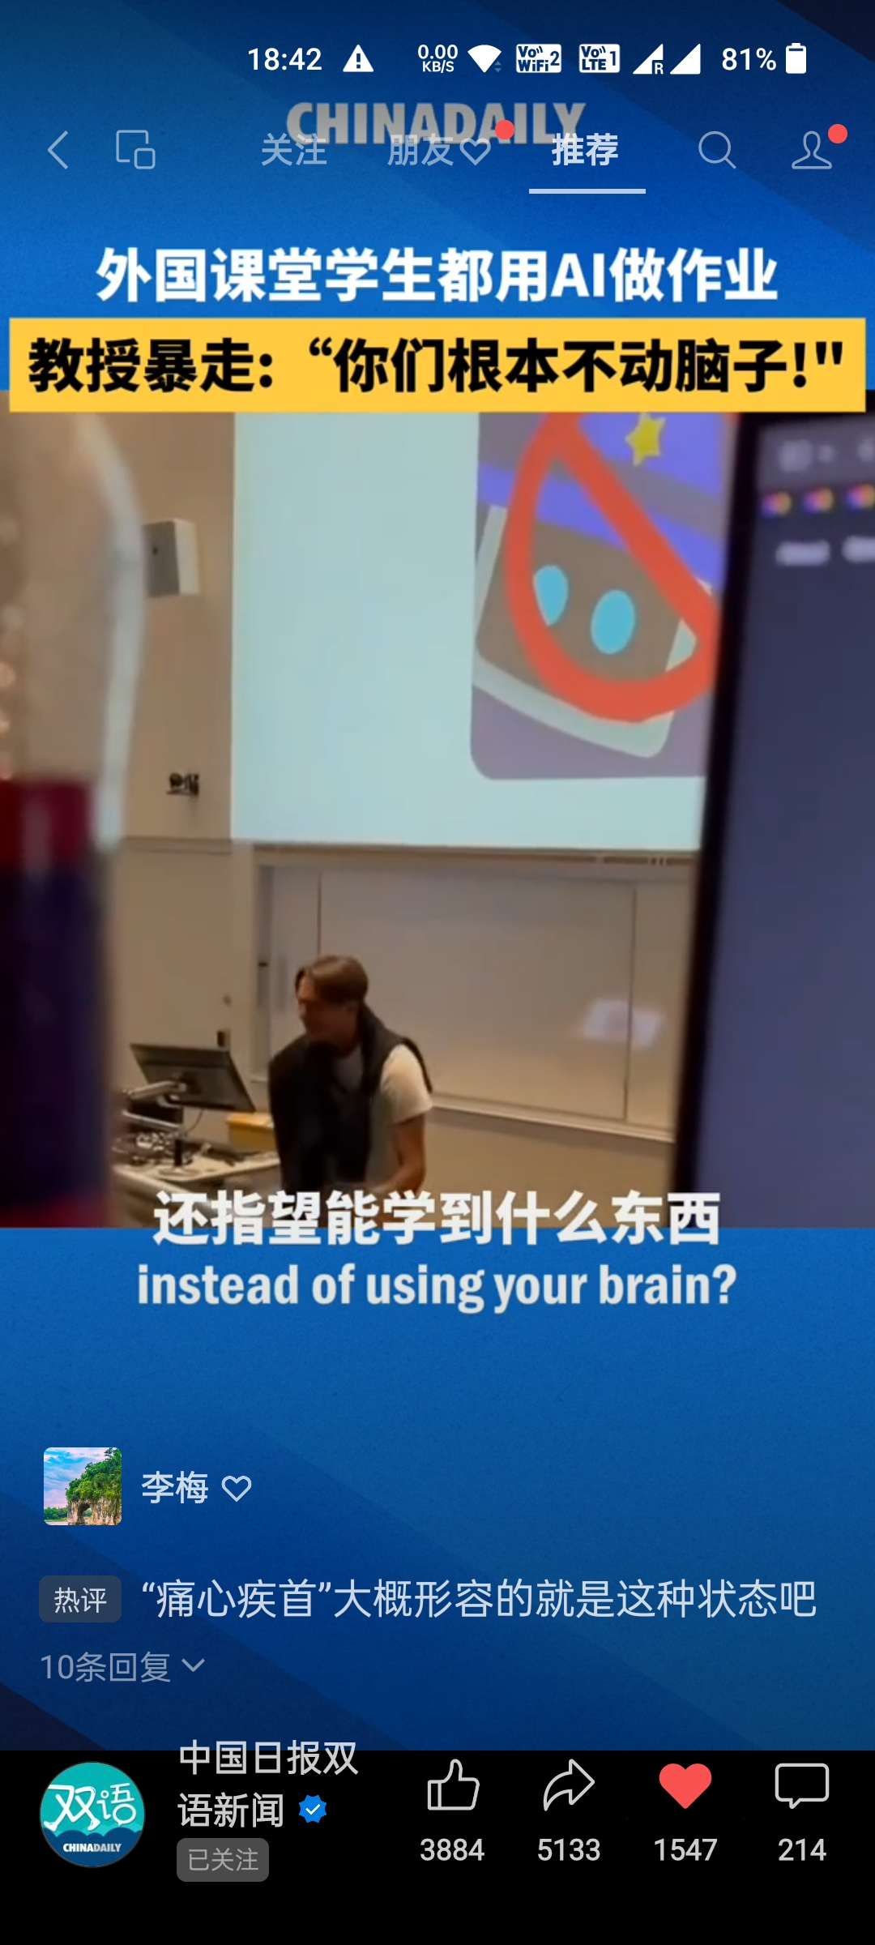

Slide 21
References
LI Yan et al. (2024) Investigation of College Students' Generative Artificial Intelligence (GAI) Usage Status and its Implication: Taking Zhejiang University as an Example, Open Education Research, 30(1): 89-98. (in Chinese)
Xiaojiao Chen et al. (2024). Empowering education development through AIGC: A systematic literature review. Education and Information Technologies (2024) 29:17485–17537
Shuchen Guo et al.(2024). Artificial intelligence in education research during 2013-2023: A review based on bibliometric analysis. Education and Information Technologies. 29:16387–16409

