Slide 1
What works best? Models for the production and transmission of knowledge in higher education
Simon Marginson
KCL, Bristol, Oxford (em.), Tsinghua (hon.)
Conference Kings College London 20 May 2025

Slide 2
Policy borrowing and institutional isomorphism (with emphasis on learning and research)
Higher education as four-part assemblage
Elements of systems and institutions patterned by similarity and difference
Global impact and limits of the Western (and primarily U.S.-American) model
Will Anglo-American university remain globally hegemonic?
Assertive states, post neoliberalism, new U.S. strategy banks on AGI not universities
University of Paris in sixteenth century

Slide 3
Propositions
Inner academic culture is partly decoupled from nation-driven regulation and funding
There has been marked cross-border convergence on basis of U.S.-led models in education and research, though not in all domains
We have entered an unstable transition, with possible pluralisation of practices (and perhaps models), but transition to what?
Stanford University

Slide 4
Four-part assemblage
global
nation state
local
European convergence
global episteme and academic culture
science, rankings
inner university
teaching/learning, knowledge, research, degree certificates
academic organisation
institutional management and practices
policy and politics
funding, regulation, performance regimes
national competition
national stakeholders
local and local-regional missions and stakeholders
local role in research universities varies

Slide 5
Civilisational convergences of institutions combining varying kinds of centralised shaping with local isomorphism
Imperial Chinese academies
Northern Indian Buddhist monasteries
Islamic madrasas attached to mosques
Medieval European universities
Land Grant universities in U.S.
Latin American megas (UNAM, USP etc)
Bologna process in Europe
Global radiation of U.S. models
University of Bologna

Slide 6
Elements of convergence and divergence
SYSTEMS
Open direct borrowing is rare, e.g. UK/Australia
Policy imaginaries
Global knowledge economy, neoliberal quasi-market, triple helix, layer of WCUs, etc
Modes of system coordination
Funding allocation, competition, planning, targets, performance, audit, accreditation/quality assurance
Systemic structures
Sectors, tiering, specialisation, differentiated research
Regulated university autonomy
Corporatisation, downward ‘responsibilisation’, NPM
Laws, regulations, political demands
Goals, policy, programmes
Funding, tuition, student support
INSTITUTIONS AND ACADEMIC CULTURES
Institutional governance
State nested? size, external/internal members
Strategic centre and administration
Leader selection, executive steering and control
University service divisions
Budget systems and controls
Decentralised academic units
Epistemic structures and cultures
Formal layers, regulated autonomy, performativity
Organisation of teaching and research
Academic work and careers
Qualification, recruitment, tenure, progression
Informal cultural conventions and norms

Slide 7
WHO is borrowing, imitating and adapting?
Policy makers at system level
Executive leaders and governing bodies at institutional and sub-institutional levels
Academic leaders in the disciplines
Academic traditions in teaching/learning, and scholarship/research, centred on partly internationalised knowledge, include the organisation of higher education in epistemic units, and the rituals of publication, student selection, assessment and graduation, have deep historical roots and part-autonomy vis a vis governments and institutional executives
University of Cambridge

Slide 8
Universities and systems in most countries have been patterned by U.S. models
U.S. global hegemony in politics, economics, science and technology 1945-2000s
U.S. had much the strongest individual institutions until the last ten years or so; global role of top British universities has been carried in American slipstream
U.S. models radiated globally via informal academic and institutional borrowing more than policy borrowing, e.g. science, rankings

Slide 9
WHAT is borrowed, imitated and adapted?
MERTONIAN NORMS OF SCIENCE
Communism: the common ownership of scientific discoveries, according to which scientists give up intellectual property in exchange for recognition and esteem.
Universalism: according to which claims to truth are evaluated in terms of universal or impersonal criteria, and not on the basis of race, class, gender, religion, or nationality;
Disinterestedness: according to which scientists are rewarded for acting in ways that outwardly appear to be selfless; and
Organised skepticism: all ideas must be tested and are subject to rigorous, structured community scrutiny
American university is Mertonian science in a Humboldtian university – while also entrepreneurial, positioned in markets
Humboldtian model: autonomous university wholly at the service of the state, on the basis of freedoms to learn, teach, inquire and express within fields
1942 Mertonian norms underpin Science: The Endless Frontier (1945)
Neoliberalism fostered inner tensions without jettisoning Humboldt/Merton

Slide 10
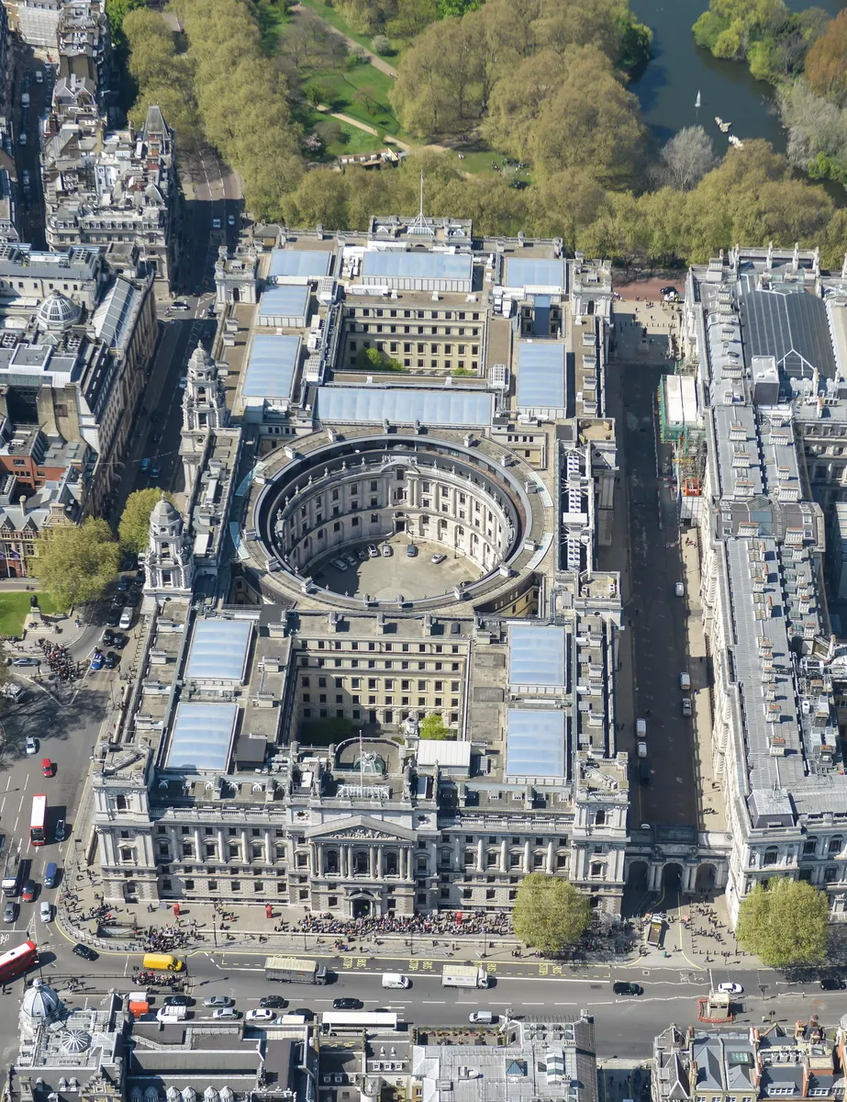
Academic cultures in education, research, service partly decoupled from policy, funding, governance
England: wholly tuition funded and regulated as a market, ‘hyper-commodified’ system (Boliver and Promenzio, 2025), but –
Successive studies find students have multiple identities, consumer is not the most important
In 2017-2021 CGHE research policy professionals and university interviewees argued for a broad role of universities in servicing public good, critiqued narrow economic framing of higher education
U.K. government in Westminster

Slide 11
Worldwide impact and limits of U.S. university models
Model | Worldwide radiation
Diverse system in terms of institutional types, stratified by resources and prestige | Few systems as heterogenous as U.S., stratification varies, non-university tertiary varies, layer of research universities is common
Mixed public and private funding, some high tuition, non-profit and for-profit private sectors | Private funding increasing in many countries, marketisation and private sectors vary greatly, research universities heavily subsidised
Corporate universities with entrepreneurial presidents; ideally, government at arms length | Neoliberal corporatisation widespread, governments retain control, much variation in executive practices and governing bodies
Competition between institutions leading to isomorphism punctuated by innovations | Competition between institutions normalised in most countries and in the global scale, growing role of marketing
Western episteme with American twist (liberal arts first degrees) | Western episteme near universal in sciences, much non science, English language has global primacy, liberal arts less strong
U.S. academic degree structures | Partial global convergence to U.S. structures and forms including in doctoral education (but many and significant exceptions)
Mertonian norms in science, open publication | Global science has been patterned by U.S. cultures including bottom-up cooperation, peer review, Mertonian norms
U.S. norms of academic profession including career formation, (negative) academic freedom | Widespread not universal impact of U.S. norms (e.g. position nomenclature, tenure), academic freedom is nationally nuanced

Slide 12
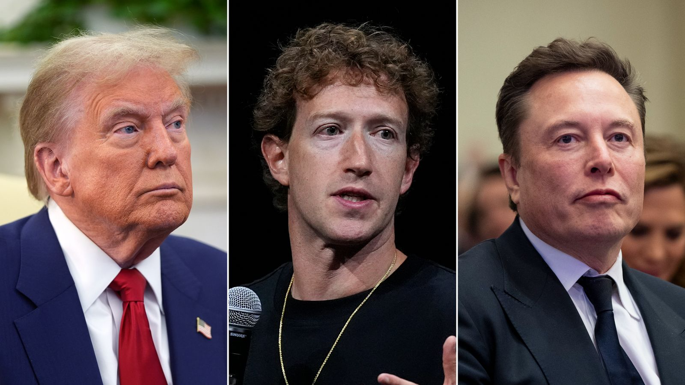
But now it’s all changing . . .

Slide 13
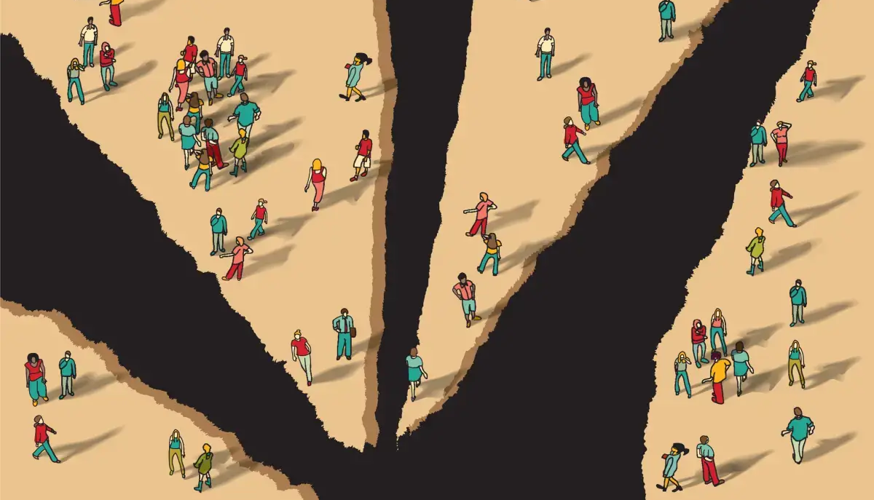
Continued global convergence, fragmented U.S. hegemony, global diversity more obvious

Slide 14
Continued global convergence, fragmented U.S. hegemony, global diversity more obvious
‘What is different about our time is that globalisation forces us to live all jumbled together, and yet we have very different visions of what this common world should look like.’
~ Bruno Macaes, The dawn of Eurasia: On the trail of the new world order, 2018, Penguin, p. 2

Slide 15
The global balance of power in science is shifting
North America
Non Western
North America
Non Western
Other Western
Other Western
Scopus 2003
Scopus 2022
Total volume of papers. ‘Other Western’ includes all Europe including Russia and European settler states Israel, Australia and New Zealand, not South Africa, Latin America and other former colonies. Mexico in ‘non-Western’ rather than North America. Data source: U.S. NSB

Slide 16
Will U.S. models in higher education remain primary?
Global spread of capacity – especially rise of China, Singapore, much of East/SE Asia, India, Brazil, in science, and also the strengthening of Europe – provides conditions for pluralisation of practices and maybe models
American global power remains intact and formative for now, especially in models of education and research
An early shift might be the pluralisation of cross-border language
BUT BUT BUT the grounds of the question are shifting, as well as the answer: the American models have become highly unstable, Trump versus Harvard is battle over Humboldtian and Mertonian norms

Slide 17
Post neoliberalism, more assertive states
Fractured geopolitics and national political instability in the West
China/Singapore show that state-led economies and universities deliver
In the Anglosphere, governmental disillusionment with market outcomes in higher education, more impatience with academic norms: arbitrary interventions
Techno-nationalism in universities, e.g. U.S.-instigated decoupling with China
Turnbull, et al. (2024). Revaluing and devaluing higher education beyond neoliberalism: Elitist, productivist, and populist policy and rhetoric in a field of conflict, European Journal of Education, 23 (5), https://doi.org/10.1177/14749041241272627

Slide 18
U.S. norms are changing fast!
U.S. administration wants to break U.S. university power, Humboldtian autonomy/freedoms, Mertonian science
Massive reductions in direct research funding of university science via NIH, NSF (55% budget cut), many current grants terminated midstream
It’s not just ideological, not just climate science
Massive public and private investment in AI: $500 billion for Stargate, Artificial General Intelligence (AGI) research, and $500 billion for Nvidia, chip development and AI infrastructure

Slide 19
The consensus on university-led innovation is gone – now two competing mega models
The U.S. expects evolving AGI in 5,400 data centres, run on top-down basis and integrated with national security, to drive future scientific innovation (and perhaps programming of societies, polities, world)
China and Europe likely to maintain open science in distributed universities and multiple disciplines
U.S. tech oligopoly, China favours open source in AI and universal AI competences in higher education

Slide 20
Conclusions
Online has not overturned tradition. High corporate AGI does. Future of global academic culture unclear, future of research university form unclear
Conditions encourage national/regional approaches
Non U.S. versions of the inherited U.S. university models might be more influential in future
Borrowing and imitation will continue, with more plural options – and for governments, a binary choice about orientation to U.S.-led AI
U.S. universities less attractive, many scientists and research fields now outsiders: reshapes talent flows

