Slide 1
European university funding models
Thomas Estermann
Director for Governance, Funding & Public Policy Development
UNICA 19 May 2025

Slide 2
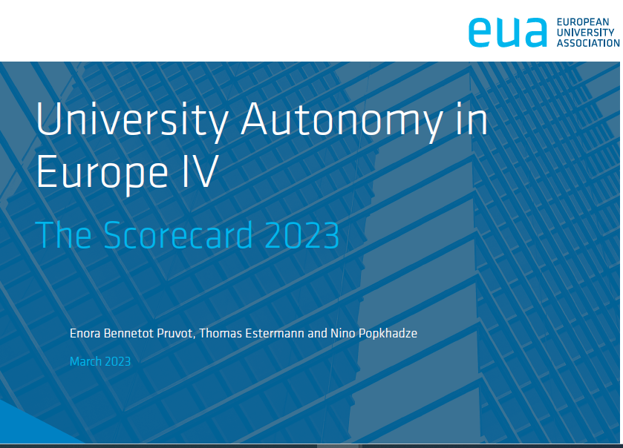


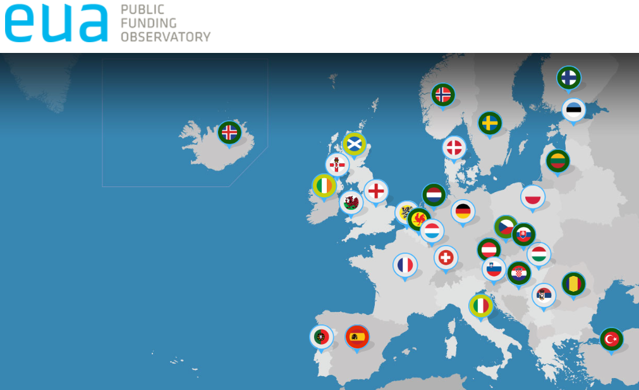

EUA’s work on funding and institutional autonomy
System and institutional perspective:
Public funding models in Europe
Public Funding Observatory/ Funding trends
University autonomy in Europe/ Financial autonomy
Diversification of income streams

Slide 3

Outline
Basic principles
Trends
Who/what influences
Examples
The future

Slide 4
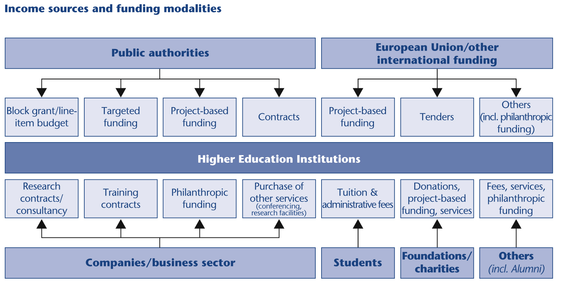
Funding and modalities For UNIVERSITIES
A Funding model is a combination of instruments, rules and financial flows.
Notes:
A funding model is not a single mechanism but a combination of instruments, rules, and financial flows.
Main components:
Sources of income (public funding, tuition fees, third-party income, philanthropy, etc.)
Types of funding (block grants, competitive funding, targeted funding)
Allocation mechanisms (formula-based, performance-based, negotiated)
Governance of funding (who decides, under what conditions, with how much transparency or flexibility)

Slide 5

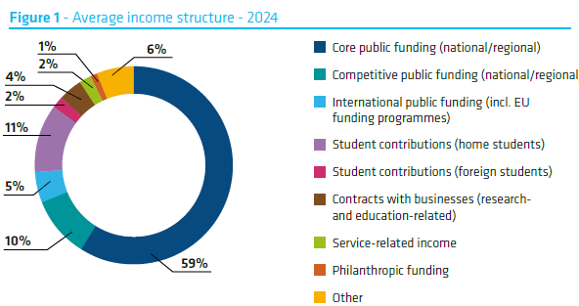
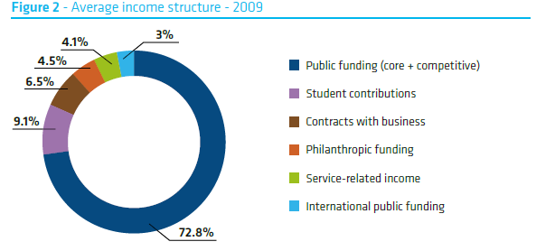
Average income structure
2024
2009

Slide 6
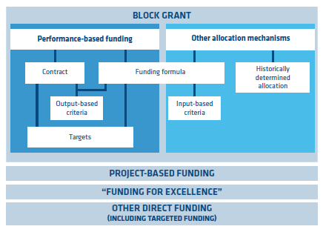
Public Funding tools
Finding the right mix of public funding tools
Taking account of high percentage of fixed costs
Holistic approach to university activities
Awareness of unintended consequences
Notes:
Understood very differently across systems
Distributed as core funding.
Parameters related to performance - output (at different stages) of a process of learning/teaching, research or interaction with external stakeholders.
Two ways:
Funding formula.
Contracts/agreements: goals/targets agreed between funder and universities, the (non-) completion of which may have an impact on the level of funding.
Used interchangeably with other mechanisms:
“Formula-based funding”
“Competitive-funding”
“Contracts”
Variables refer to the past, while targets refer to future achievement, for instance regarding enrolment.

Slide 7
Country | Funding formula | Input-related indicators | Output-related indicators | Performance contract | Historical/negotiated/ fixed allocation | Country | Funding formula | Input-related indicators | Output-related indicators | Performance contract | Historical/negotiated/ fixed allocation
AT | X |  | X | X |  | IE | X | X | X | X
BE-fr | X | X |  |  | X | IS | X | X | X | (X)
BE-nl | X | X | X |  |  | IT | X | X | X | X | X
CH | X | X | X | X |  | LT | X | X | X
CZ | X | X | X |  |  | LU |  |  |  | X
DE | X | X | X | X | X | NL | X | X | X |  | X
EE | X |  | X | X | X | NO | X | (X) | X | (X) | X
ES-ca | X | X | X | X | X | PL | X | X | X |  | X
ES-ma | X | X | X |  |  | RO (t) | X | X | X
DK | X |  | X | X | X (r) | RS | X | X | (X)
FI | X |  | X | X |  | SE | X | X (t,r) | X | X | X (r )
FR |  |  |  | X | X | SK | X | X | X | X
HR | X | X | X | X |  | UK-en | X | X (t) | X (r)
HU | X | X |  |  |  | UK-sc | X | X (t) | X (r) | X (t)
Multiannual funding models for universities in Europe
Notes:
(t) mechanisms that fund exclusively teaching activities or research (r) activities.

Slide 8
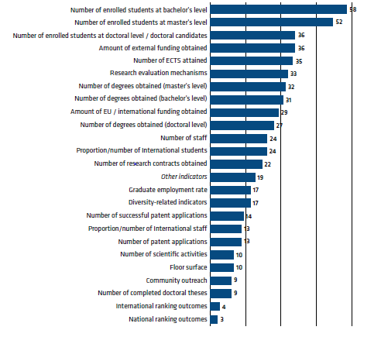
Indicators used in European HE systems
Student numbers still most important
Attained degrees (output version)
Research evaluation mechanisms
Graduate employment rates became more relevant

Slide 9
What influences funding models
Culture
National politics
European policies
Economic development
International trends
Peer learning
Higher education research
Stakeholder organisations

Slide 10


Please rate the impact of the different drivers on the development of funding models/instruments in your system, using a total of 100 points
Use the code: 8899 7425
Notes:
https://www.menti.com/altg6o8m4nak
The audience needs to rate the impact of the different drivers on the development of models/instruments in their system, using a total of 100 points

Slide 11
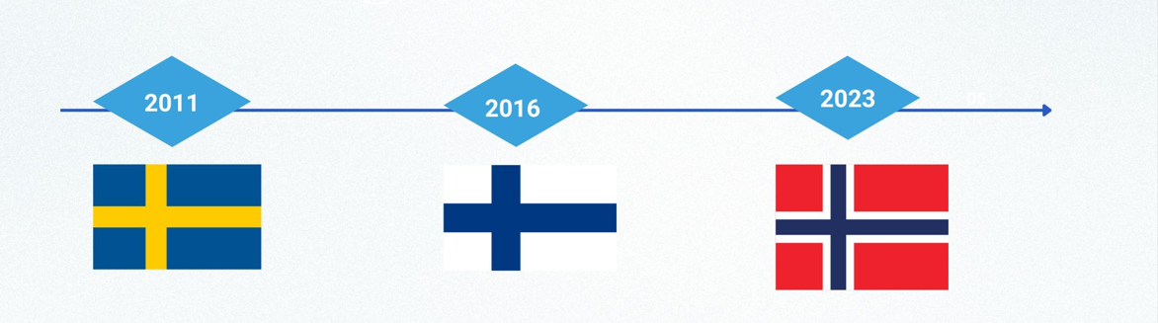

Culture
Nordic tradition of models without fees, but introduction for international students…
From 8000 to 15,000
From 8000 to 20,000
From 7000 to 9000

Slide 12
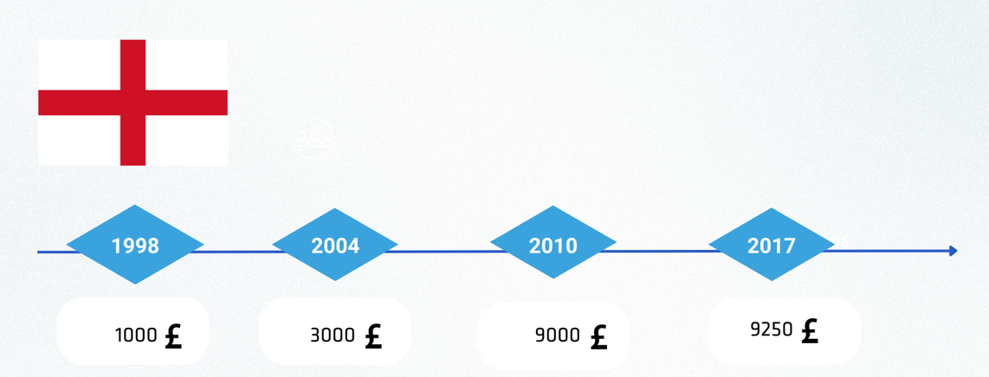

National Politics
The development of tuition fees for BA students in England

Slide 13



European Policies
While EU funds and programmes are significant, they must not replace…..national public funding and other public and private investments. I
…..reconcile the objectives of effectiveness, equity and efficiency.
…..strike the right balance between core, competitive and outcome-based funding
Notes:
Modernisation agenda 2006:
Universities should be funded more for what they do than for what they are, by focusing funding on relevant outputs rather than on inputs, and by adapting funding to the diversity of institutional profiles.”
“Each country should therefore strike the right balance between core, competitive and outcome-based funding (underpinned by robust quality assurance) for higher education and university-based research.
Renewed EU Agenda for Higher Education (2017)
European strategy for Universities in 2022

Slide 14
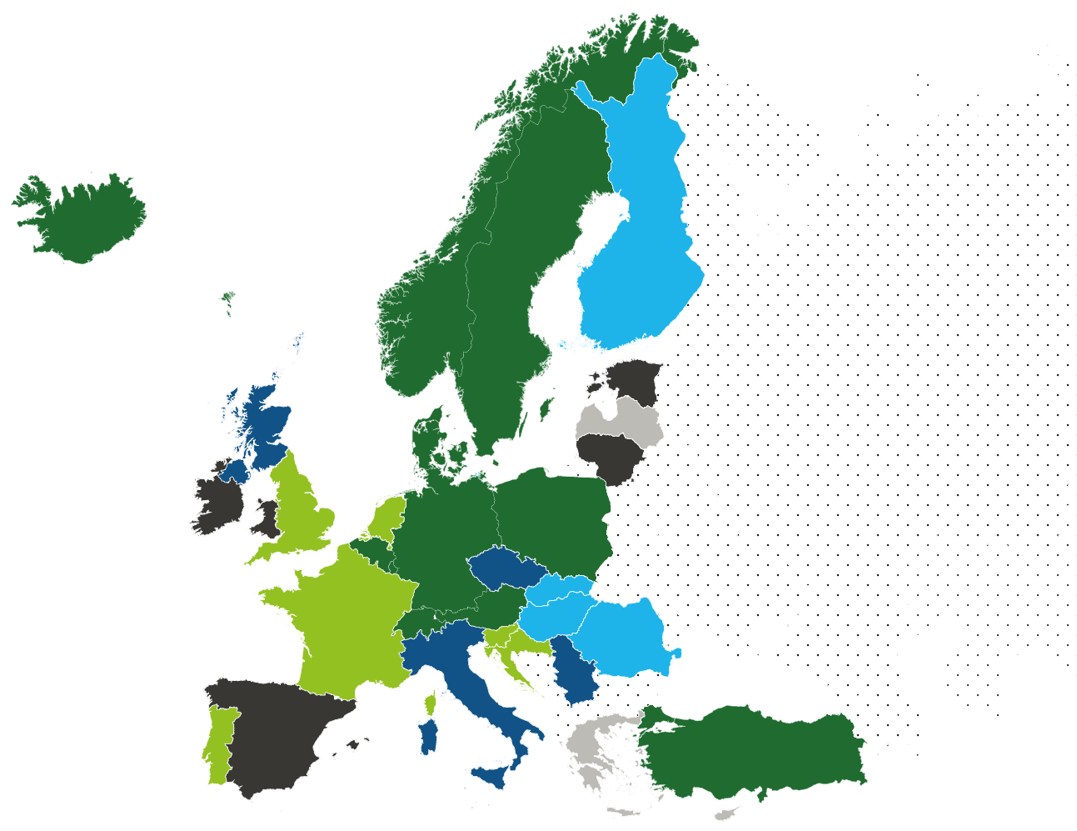
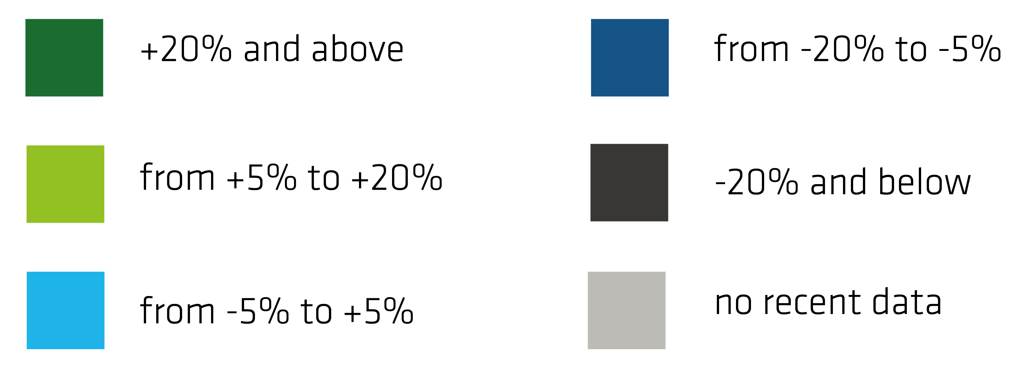

Economic development
Long-term effects with impact on autonomy, resources and staff
Covid-19 played out diversly
Reform plans relaunched through NextGenEU
Impact through International conflicts, energy crises, inflation
Source: PFO 2020/2021

Slide 15
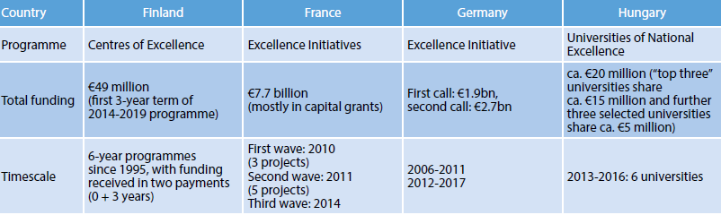
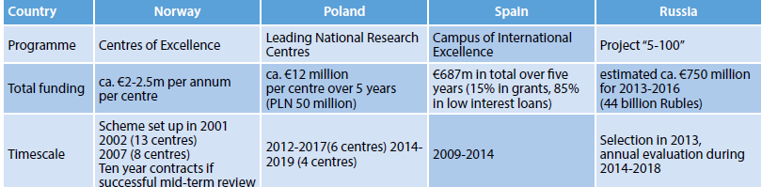

International trends
Excellence schemes
Source: DEFINE report 2015

Slide 16




Peer learning
Timeline Introduction of funding formulae

Slide 17




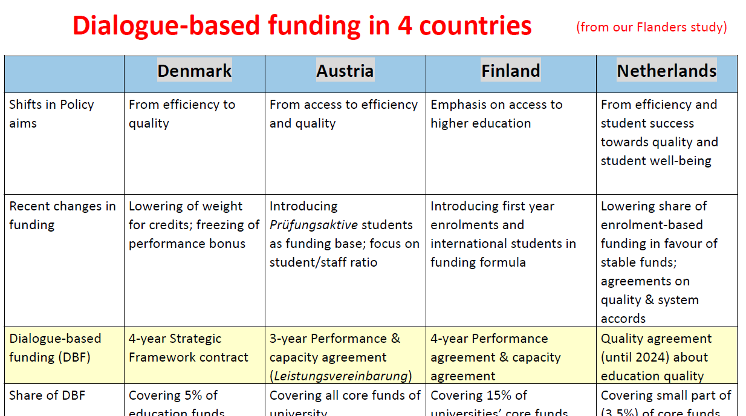
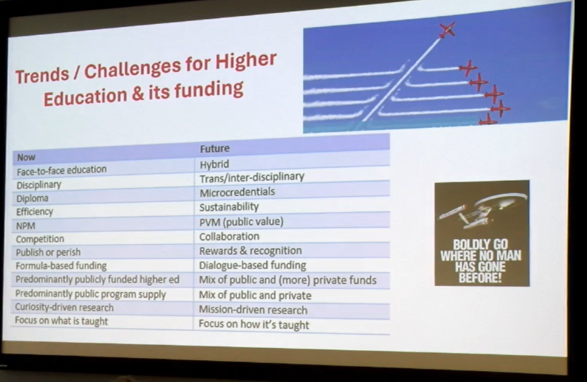
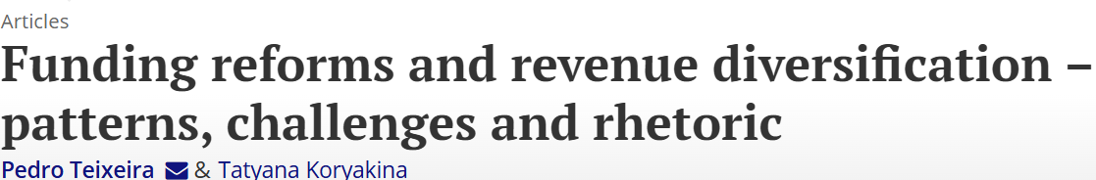
HE research
Funding a highly researched area

Slide 18



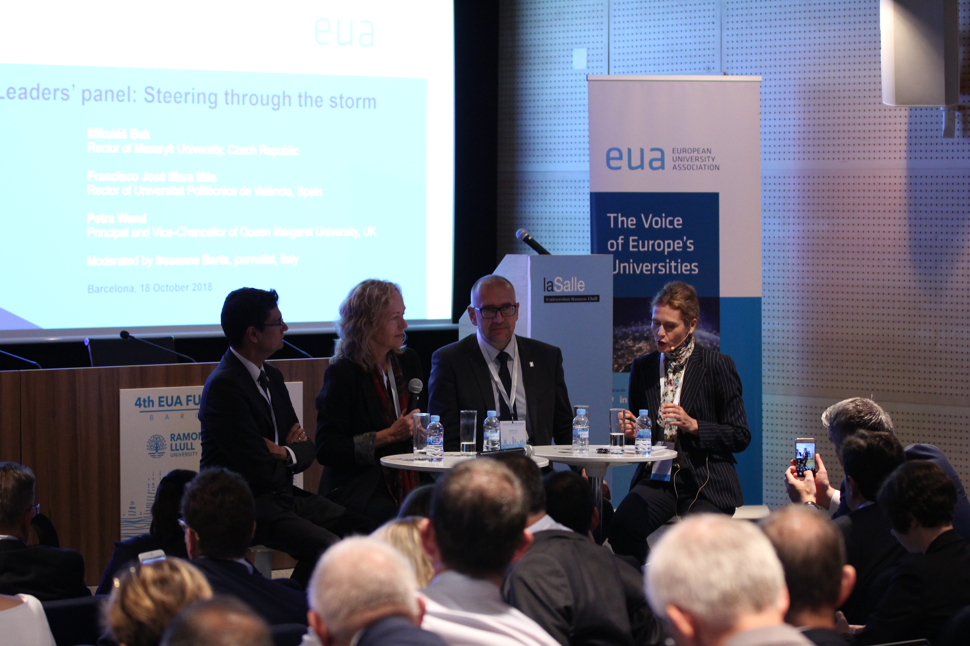

Stakeholders
EUA Funding Forum
Comparative studies
Capacity building projects
Expert missions
National reform dialogues
Notes:
ATHENA: Foster the transfer of good practices in order to promote efficient and effective governance and funding reforms

Slide 19
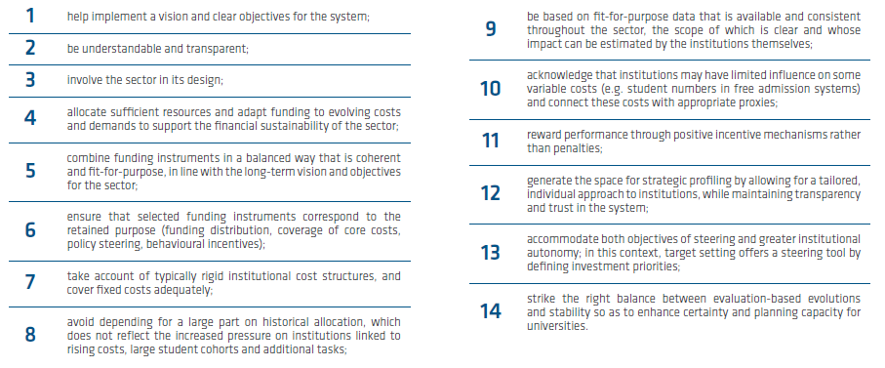
Principles for HEI funding models
Analysis
Purpose
Objectives
Tools
Evaluation
Refinement
Notes:
Variety of objectives:
Ensuring transparency of resource allocation.
Steering effect towards completion of defined policy objectives.
Incentivising goals deemed desirable by funders.
Engaging institutional-government dialogue.
Driving performance.

Slide 20
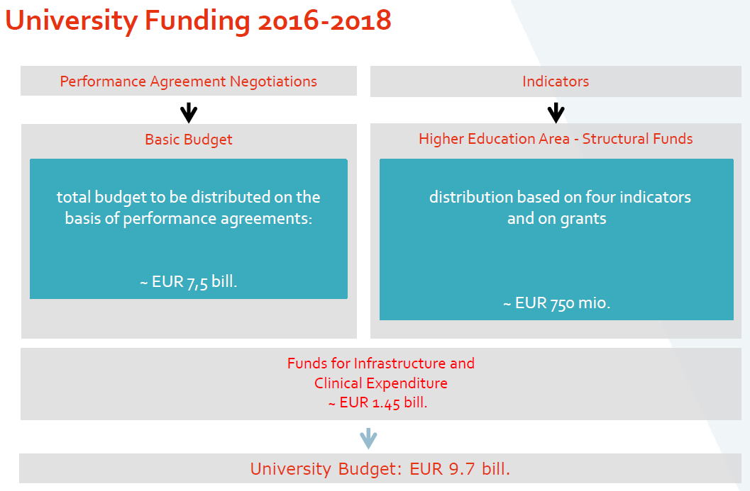
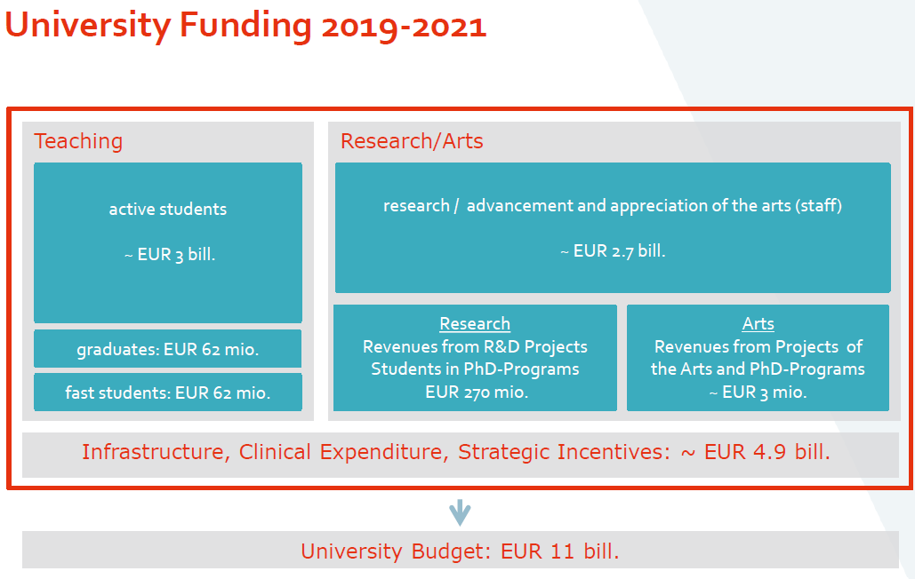
Austria as an example
Intention: performance with better account of cost structures + wider, more strategic perspective, less indicators (too complex with little steering effect)
Concerns: micromanagement through prescriptions in the agreements, notably staffing
Notes:
Only the first two pillars are calculated by using indicators. The most important component of the teaching budget is the examination activity, which is given if at least 16 ECTS credits are earned per academic year. There are seven subject groups with different funding rates (humanities, social sciences and law with €9,900 on the one end and art and music with €49,500 on the other end of the spectrum). 96% of the teaching pillar is provided through this indicator in the funding period 2022-2024. The most important indicator for research (and development of the arts) is the number of academic (or artistic) staff. The amount is calculated through the value of the subject group. 91% of the research pillar is provided through this indicator.
A specific feature of the first two pillars is that the funding allocation works with target values (for example a target for academic staff).
In teaching, 2% is awarded via the number of degrees and 2% via students who are particularly active (40 ECTS credits/year). In research, 8% is awarded through an indicator taking into account external funding and 1% through doctoral studies.
While the legal framework provides a reasonable degree of autonomy, the sector expressed concerns about a strong trend towards micro-management. This has been evident through detailed prescriptions in performance agreements and direct interventions that are very prescriptive. The ministry is seen to interfere in staffing matters through the performance agreements, specifying the number and fields of professors that universities may hire. Moreover, the prescriptive agreements result in a burdensome reporting cycle, adding to the complexity of administrative processes and draining institutional resources.

Slide 21
The future
Funding instruments to fund big transformations (such as Sustainability, Digitalisation)?
European research funding more focused and narrower?
Continued support for European University Alliances?
More steering in national funding?
More cooperation instead of competition?
Will efficiency and effectiveness be back?
More incentives for underused tools (philanthropy)?
Diversification a virtue to guarantee more independence

