Slide 1



Alumni Relations in Practice: insights from the University of CYPRUS
By Ms. Athina Frangou Selipa
University Officer
Development & Alumni Relations Office
Rectorate/Promotion & Development Sector
12/11/2025

Slide 2
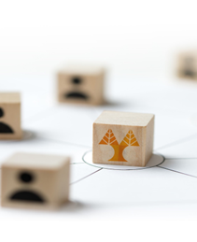
What to be covered
UCY Showcase in alumni relations and development
Focus on Governance, Strategy and Engagement Impact
Comments for discussion and ideas exchange
Notes:
Showcasing the University of Cyprus as a case study in effective alumni relations — focusing on governance, strategy, and engagement impact

Slide 3
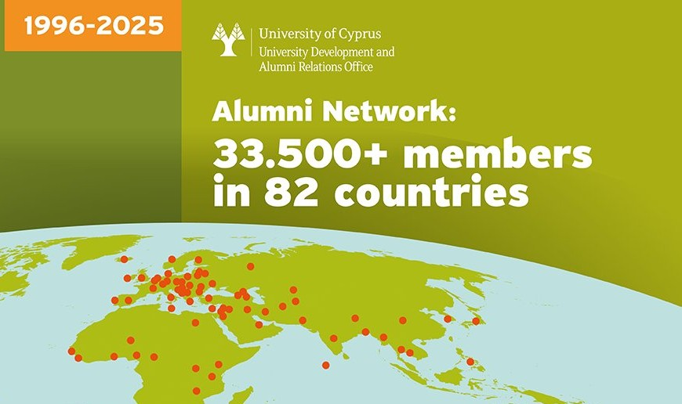
About UCY & the Development and Alumni Relations Office
1989: UCY established
1996: first alumni
2005: Alumni Relations Office
2019: Development and Alumni Relations Office (DARO)
2025: UCY vibrant community with 33.500+ alumni in 82 countries & 5.000+ supporters & 7.000 students & 900 academic and administrative staff members coming from all over the world
2025: UCY Global Rankings - TIMES (among the top 401-500), QS (389), ARWU (701-800), US Best Global University Rankings (678)
UCY Vision: Excellence, Innovation, and Service to Society
Notes:
UCY RANKINGS: world reputation rankings placing it among the top universities internationally, specifically: TIMES 2025 (among the top 401-500), QS 2025 (389), Shanghai ranking – ARWU 2024 (701-800), and US Best Global University Rankings 2024-25 (678).
UCY Vision: to establish itself as a Pioneer Research Institution achieving International Scientific Recognition in European Higher Education, offering Competitive Programmes and to become a Centre of Excellence in the wider Euro – Mediterranean Region

Slide 4
Alumni Relations & Development at UCY: Overview
Coordinated by the UCY DAR Office & Overseen by the RECTORATE
DAR Office Mission: to build a lifelong community of both alumni, supporters and other university members, through the provision of information, services and opportunities for meaningful participation and engagement
Role = the liaison/portal between alumni/donors & the UCY: to «serve» anyone who has a relationship with the UCY, while encouraging active engagement
Motto: “Once a UCY students, always a part of the UCY”
Why Alumni Relations MATTER to UCY: due to their strategic value on reputation, employability, research, and internationalization
Notes:
Its goal to generate contributions of all kinds by creating mutually beneficial and lifelong relationships between the University and its constituents, through which awareness, engagement and support for UCY are built.
We are eager to see the enhancement of the alumni’s/donor's awareness, their pride and contribution towards their alma mater, and in turn, to the society.

Slide 5
Governance Structure & Rectorate’s Organizational Chart
Rector
Promotion and Development Section
University Development and Alumni Relations Office
3 other Offices
Alumni Relations function
Development function
• Administrative model within the UCY hierarchy
• Overseen by the Rectorate, in coordination with faculties and services
• Synergies with UCY Alumni Associations for international voice
• Focus on connection, networking, learning, giving back
• Ensures alignment with the institutional strategic plan
Notes:
The UCY Rectorate’s organizational chart, to which the Development and Alumni Relations Office is attached.

Slide 6
RELATIONSHIP OF THE DAR OFFICE WITH OTHER SERVICES/STAKEHOLDERS
For UCY: The alumni comprise the most important stakeholder group for its future, along with its supporters
Development &Alumni Relations
Attract new students
Student Union
Student welfare services
Career services
Fundraising
Public relations
Higher University administration
Lifelong learning
Academic development
Business development
Notes:
DARO role demonstrates value for strategic partnerships at all levels across the university (managerial, academic etc.) and operationally with admissions, development, student life, career services and other units, that both create opportunities for meaningful alumni and donors' engagement.
DARO helps to harness this “ecosystem”, that is, a culture fostering loyalty, commitment and contribution and built around the UCY’s vision and mission.

Slide 7
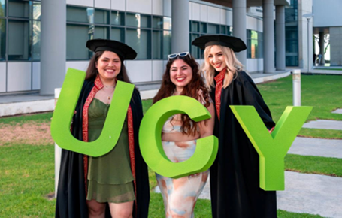
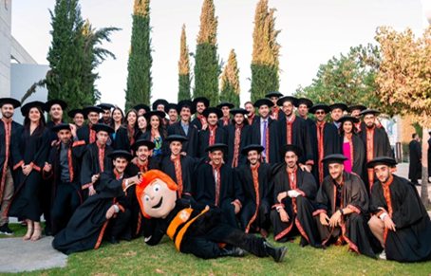
UCY Strategic Pillars of Alumni Relations
Engagement: Strengthening lifelong connection
Empowerment: Alumni as mentors and ambassadors/supporters
Learning: Lifelong development opportunities
Contribution: Time, expertise, philanthropy and voluntarism
Global Reach: Expanding the UCY’s influence internationally

Slide 8




UCY ALUMNI RELATIONS’ FUNCTION
The development of good relations between an academic institution and its alumni is a long-term investment which entails benefits for the institution beyond any financial contribution. UCY GOAL: to keep its AMBASSADORS up-to-date with the activities, goals, values and philosophy of the University, so that there can be a steady connection and contribution to the Institution on their behalf.
Main activities/programmes:
Benefits Package & Alumni Membership Card
UCY Mentor Programme
Lifelong Learning Programmes
Events
Surveys & Competitions & Campaigns
Engagement-Networking-Communication via Platform & social media & E-alums.newsletter
Notes:
UCY EAGERNESS: to see the enhancement of the alumni’s/donor's awareness, their pride and contribution towards their alma mater, and in turn, to the society.

Slide 9
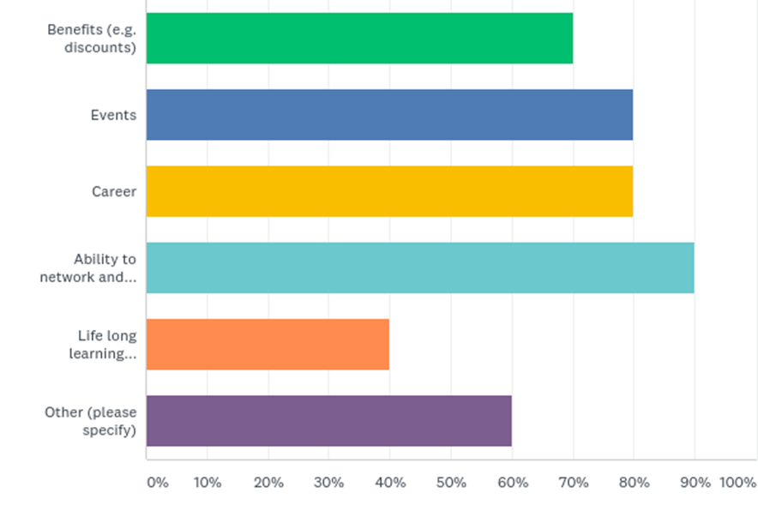
UCY DARO Services
Among all the services offered there is emphasis on offering networking opportunities to the Alumni Community.
Notes:
Other:
We offer the Mentor Programme and Coachcafes to young alumni, where they are coached by senior alumni-mentors.
We offer benefits, events and career for students.
We give the opportunity to all community members to participate in university actions (e.g. present their company to students, giving challenges to students, participating in events)
We support the establishment of regional Alumni groups (nationally and internationally), as well as the establishment of Interest Clubs (Books, Bicycle, Marathon Club and others)
Ability to be approached by universities (only if they opt-in for this service)
Concerning the LLPs, we facilitate the applications for these programs.

Slide 10



UCY DONORS RELATIONS’ FUNCTION
The UCY boasts of its growing body of benefactors and donors whose names are linked to key milestone moments in the realization of its vision.
Main activities:
Areas to Support | Why I Give | Major Benefactors
Fundraising campaigns: "Building the City of Knowledge",
"Action for Education", "Research Saves Lives", "UCY Giving Back"
Development & Philanthropy & Voluntarism & Engagement
Events & activities (for donors’ public acknowledgement, their impact-focused recognition
Communication & support (Platforms, E-donnors.newsletter, personalized letters/emails, videos, social media etc.)
Notes:
Our GOAL: also to keep the alumni & other community members up-to-date with the activities, goals, values and philosophy of the University, so that there can be a steady connection and contribution to the Institution on their behalf.

Slide 11
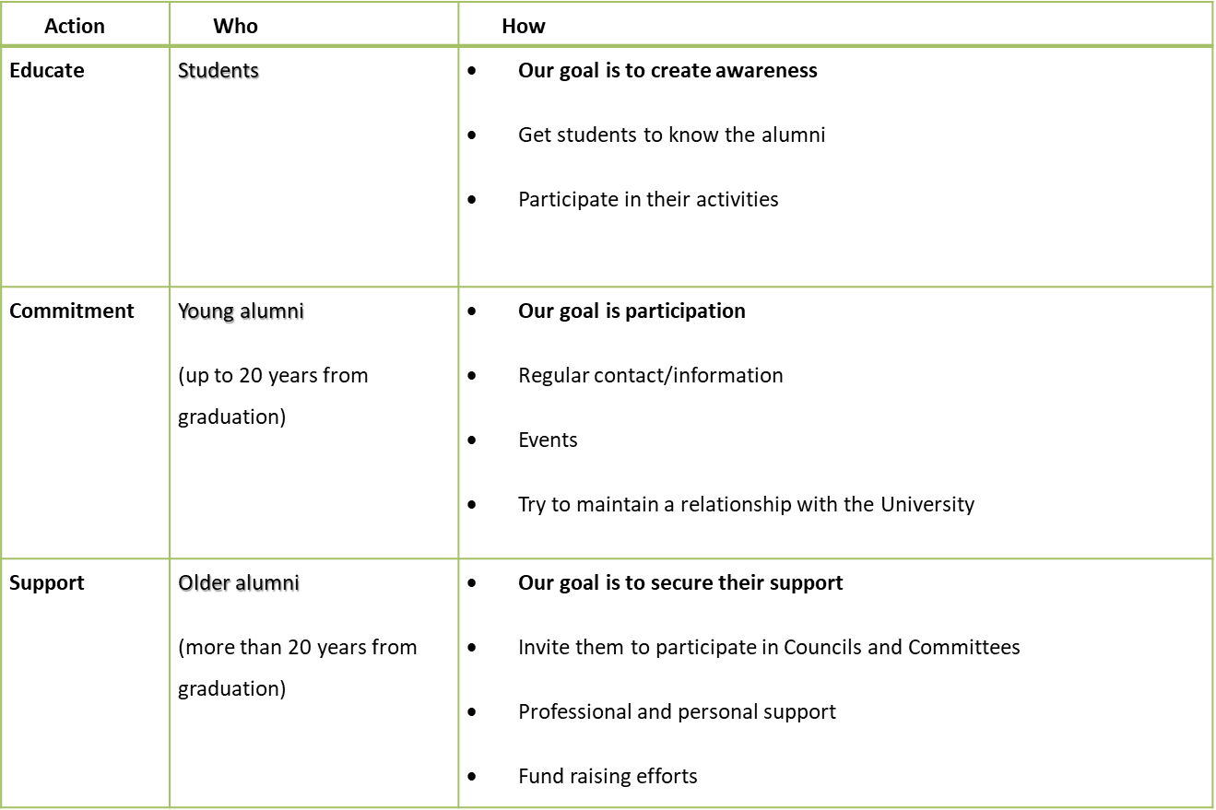
UCY SENIOR STUDENTS & ALUMNI APPROACH AND ENGAGEMENT
DIGITALLY & IN-PERSON
Notes:
DARO’s approach is to inform the current student community about the alumni office and its activities and then keep them engaged after they graduate and finally encourage their support when they mature professionally.

Slide 12

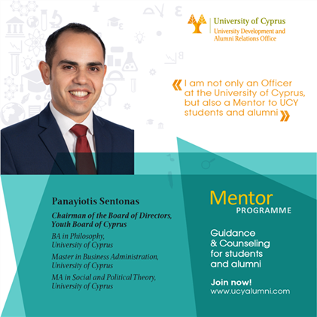
UCY GOAL ON ALUMNI & DONORS COMMUNICATION AND ENGAGMENT
• GOAL: to sustain/GROW a proud alumni and donors' community, with philanthropic culture, mentorship and entrepreneurial impact, fully networked and dynamically engaged in person and/or digitally, contributing to UCY’s success, while adding value to the society.

Slide 13


UCY ALUMNI & DONORS ENGAGMENT TOOLS/CHANNELS
Alums & donors PLATFORMS: networking, updates, registration, and data management (www. ucyalumni.com)
• Social media: LinkedIn, Facebook, Instagram, Tic Toc, Youtube
• E-alums.newsletter (Monthly) & E-donors.newsletter (2/year)
Website www.ucy.ac.cy/alumni-development/
Podcasting (alums & donors testimonials, Science Talks)
Email (mailing lists) & Personal contact (customer service line) & Phone calls/SMS
Exclusive electronic and printed publications
Surveys (conducted digitally & by phone)

Slide 14
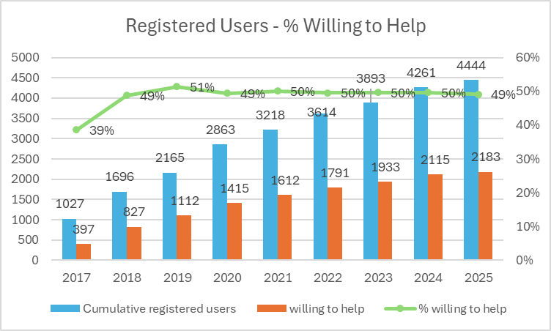
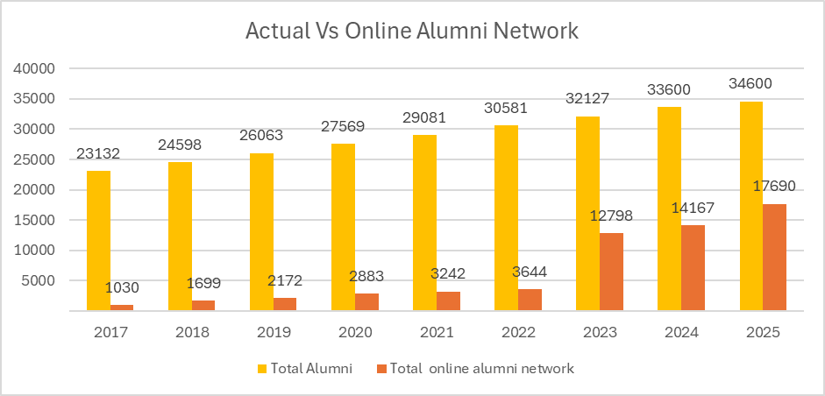
UCY MEASURING SUCCESS IN ENGAGMENT& COMMUNICATION
Engagement KPIs: participation rates, event attendance, mentorship RELATIONSHIPS
Data systems for tracking connection and contribution
Qualitative feedback through alumni surveys
Benchmarking against national & international best practice

Slide 15
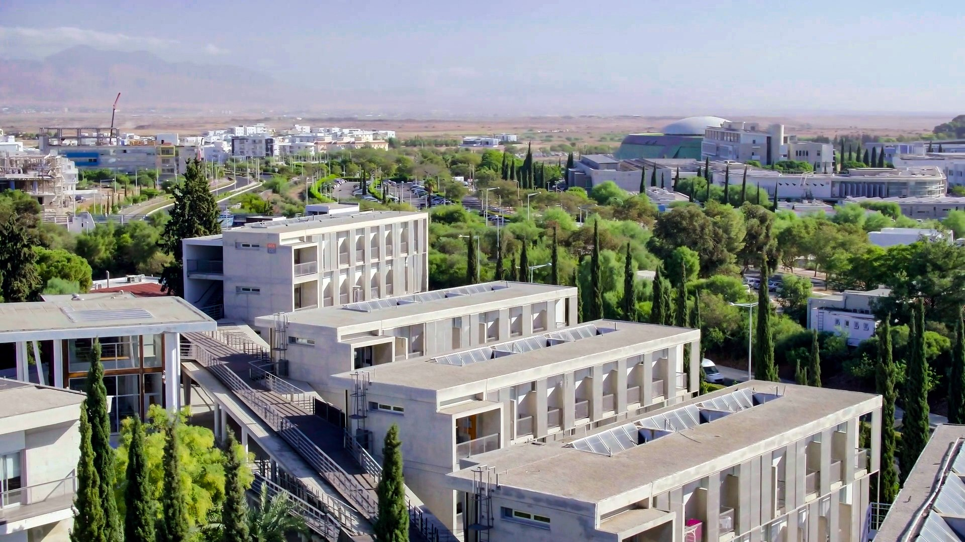
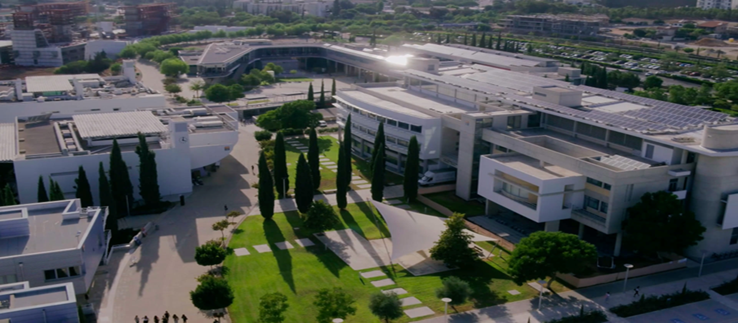
THANK YOU
Comments for discussion and ideas exchange are welcome!

