Slide 1
From framework to practice:
three key factors in academic freedom

Slide 2



Debate and dispute…

Slide 3

Implementing frameworks for academic freedom:
What happens?

Slide 4
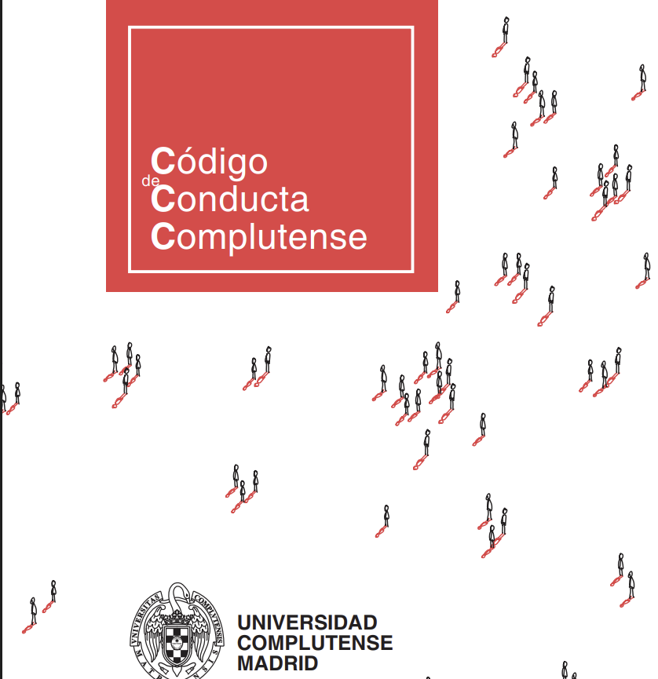
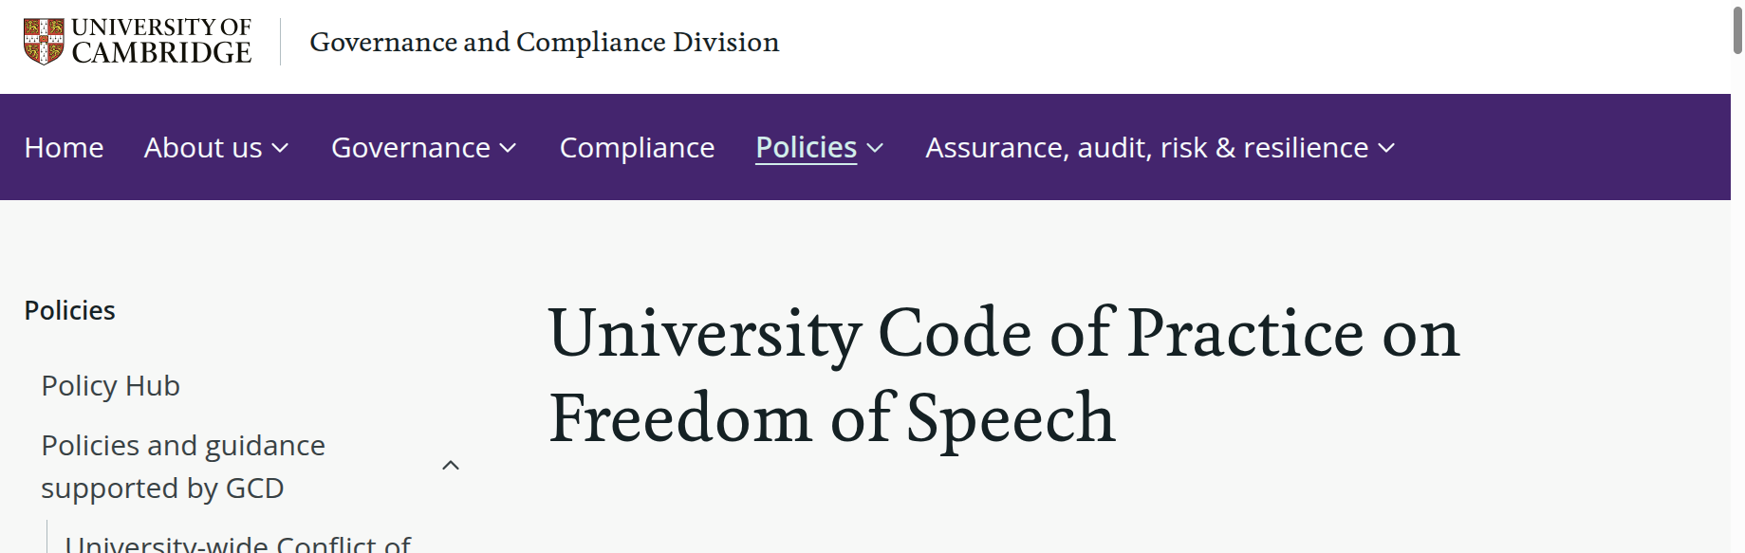
Measures that can be taken by universities

Slide 5
Combinations of qualitatively different measures
Cambridge
Procedures eg programme development, EDI, research facilitation, room booking
Information: "ensure that this Code of Practice is brought to the attention of new students at registration and new staff during induction"
Training: mandatory core online training module for all staff
Guidance: eg specific guidance for those involved in governance, those involved in complaint processes

Slide 6
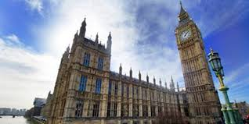
2. The question of autonomy
Procedures for academic freedom aim to protect academic autonomy…
BUT…
Universities are not fully autonomous in matters of academic freedom

Slide 7
Outside bodies can decide…
What academic freedom is (and how precisely it is defined)
How universities are required to implement it
Whether the universities have done so to the satisfaction of the outside body

Slide 8

Key decision makers include…
Founders of constitutions (in some countries)
Governments
Accrediting / regulatory bodies
Funders
Suprnational authorities (ECHR and Article 10 European Convention on Human Rights)

Slide 9
Example of University of Cambridge

Slide 10

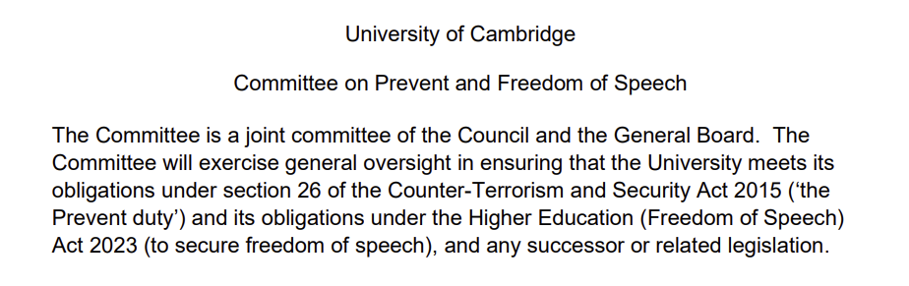
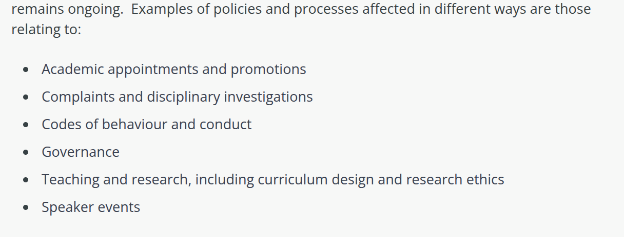
Mutability of external decision makers

Slide 11
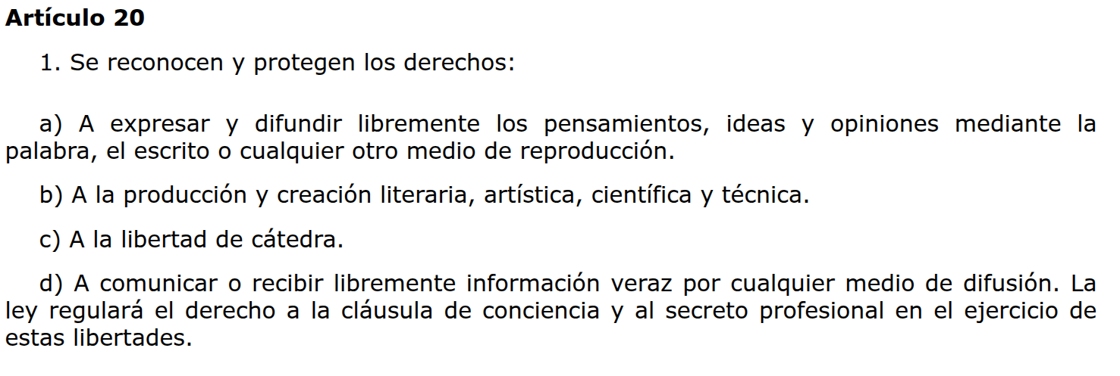
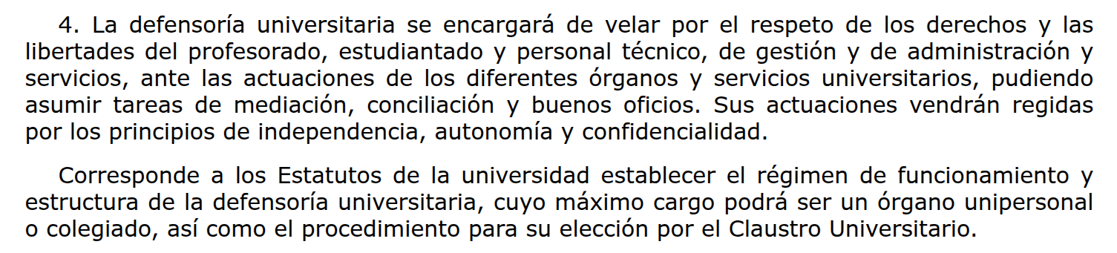
Dependency on context

Slide 12
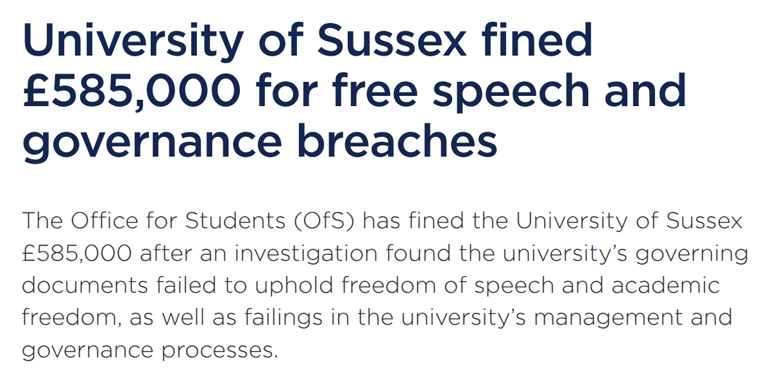
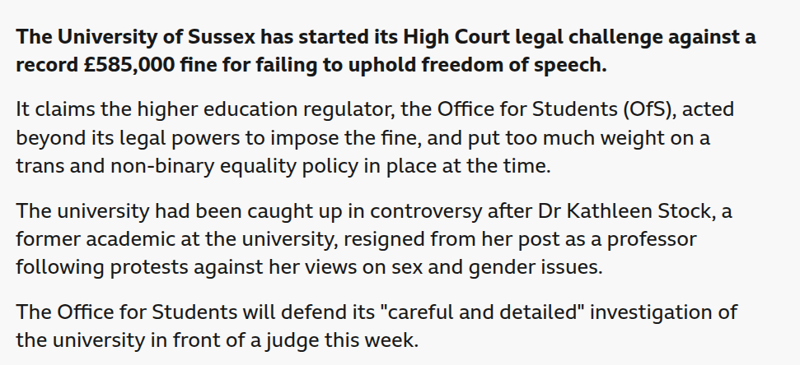
3. Open to external tests and challenges

Slide 13
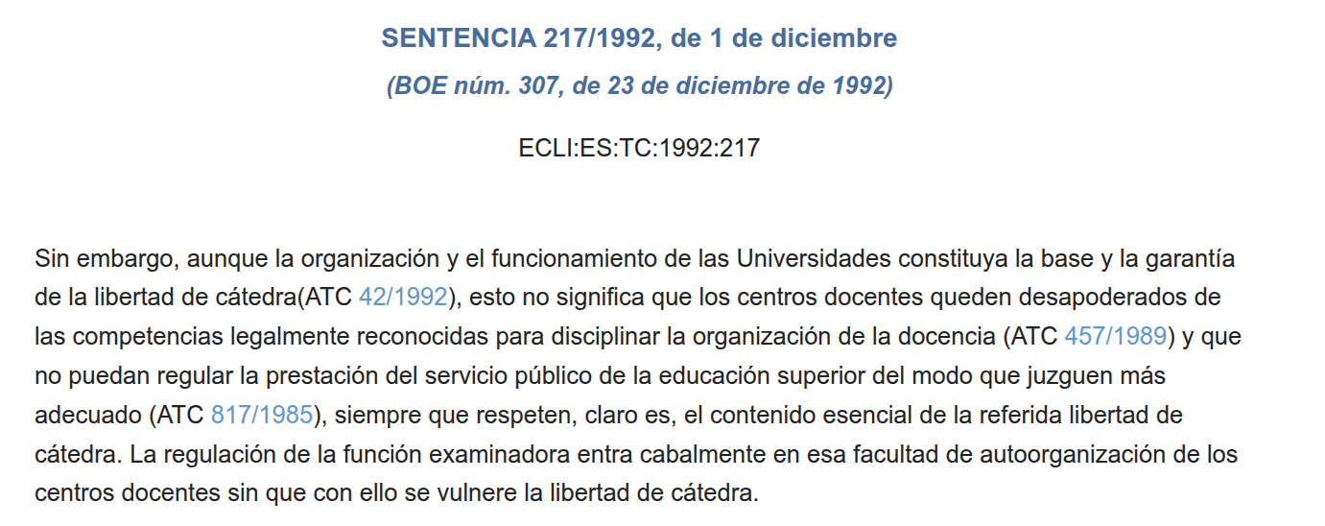
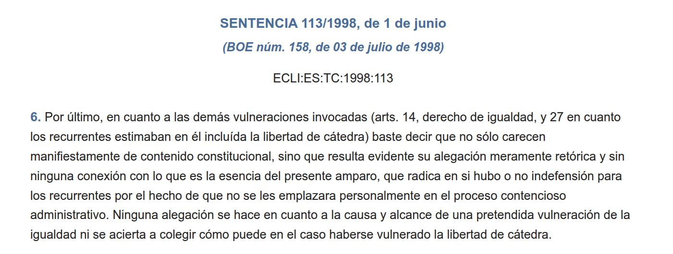
… and so subject to court decisions

Slide 14
Orientation: Schema of Implementation of Freedom
University interventions
External rule making
External challenge
Public debate

