Slide 1

Academic Freedom as Institutional Design
Professor David Smith, Convenor: University Academic Freedom
and Freedom of Expression Working Group

Slide 2
Academic Freedom as Institutional Design
Typically framed as compliance, commitment to free speech, statement of institutional values
Often managed episodically
Key shift: Academic freedom must be sustained through how an institution is organised and operates:
Grounded in institutional purpose
Enacted through leadership, governance, and structure
Academic Freedom at scale requires more than defence; it requires institutional design

Slide 3
Academic Freedom as Institutional Capability
Built into how the University is organised and operates
Requires:
Oversight through defined governance structures
Clear understanding of what academic freedom means in practice
Integration into routine processes and academic practice
The ability to anticipate emerging challenges
An evidence base to inform judgment and decision-making

Slide 4

Case: University of Edinburgh
50,000 students; 13,000+ staff (FTE)
Global, research-intensive university
Highly international academic community
Significant public and political visibility
At this scale, episodic response is insufficient
Academic freedom most visible in moments of controversy

Slide 5



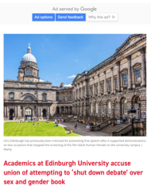

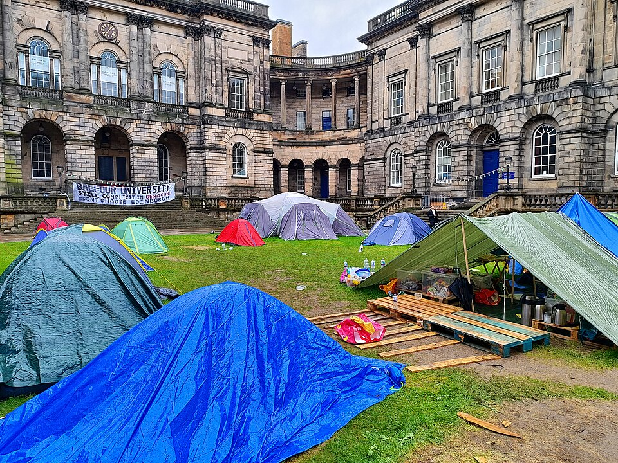
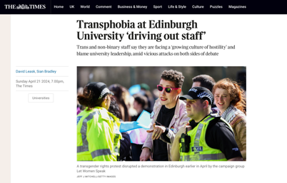

Our context

Slide 6
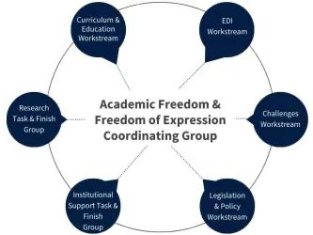
Case: University of Edinburgh (2023-2026)
University governance structure:
University Executive Group
Liaison Group (Provost, University Secretary, Associate VP Education, Head of Provost’s Office)
Coordinating Group (including Joint Trade Unions; Student Association)
Workstreams
Senate and University Executive reporting
Linked structures distributing oversight and coordinating institutional decision-making

Slide 7
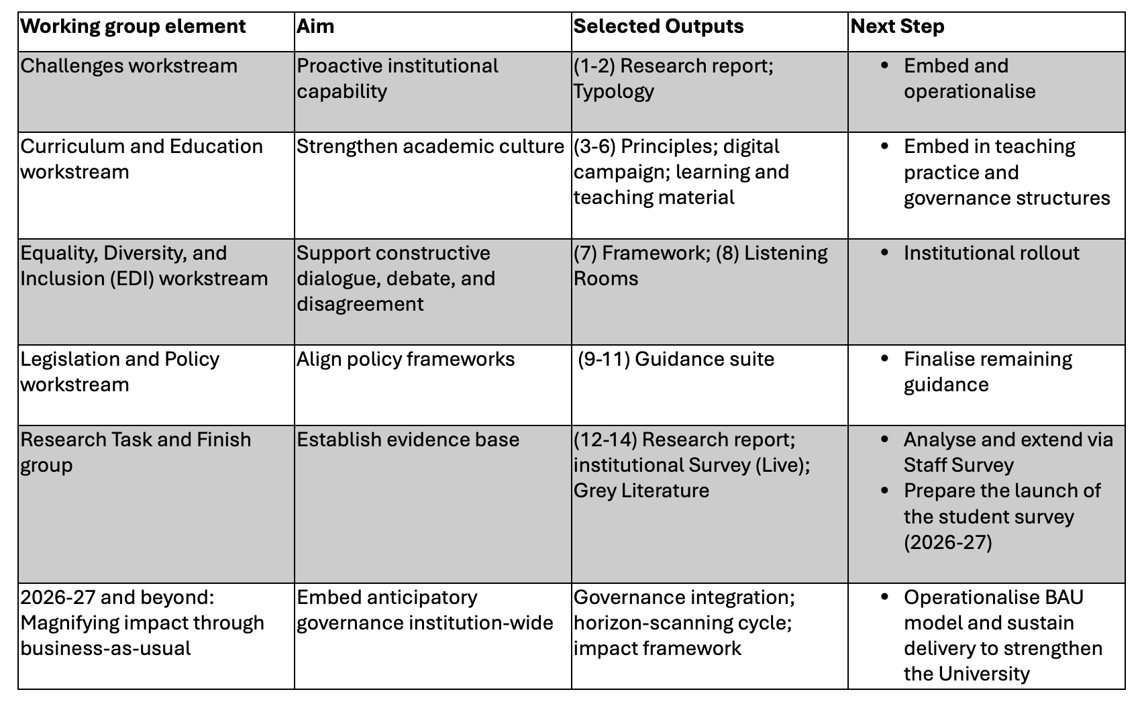

Slide 8
Case: Edinburgh: Business as Usual (BAU) - Oversight Group (2026-)
Horizon Scan
Typology Refresh
Risk Register
Oversight Group Evaluation
Actions Remitted
Delivery Oversight
Annual Reporting

Slide 9

Case: University of Edinburgh
Legitimacy construction
Distributed governance (hub and spoke)
Anticipatory capability
Policy and governance coherence
Integration within existing systems (not parallel structures)
Clarity for staff and students in how academic freedom is exercised in practice
Longitudinal data to inform future action

