Slide 1
The EU’s quest for Academic Freedom in a Changing Geopolitical World
Jan Palmowski, May 2026

Slide 2
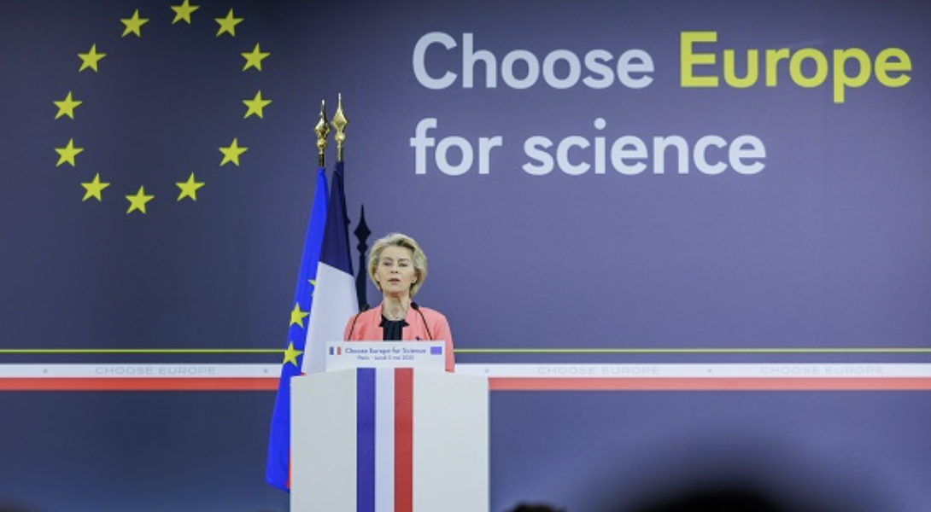
The Ambition:
And Yet….
“The First Priority is to ensure that science in Europe remains open and free. This is our calling card. We must do everything we can to uphold it”
‘The success of radical ideologies that seek to replace competence and merit with favored group status would render America unrecognizable and unable to defend itself.’… (11)
’The US must develop the most advanced technologies, bolster our society’s cultural health, and field the world’s most capable military’ (9)
US National Security Strategy 2025

Slide 3
‘there are countries that combine authoritarian regimes and the near absence of academic freedom with eminence in research and innovation’ (European Commission, 2025)
What has driven the EU’s commitment to Academic Freedom?
What does the Commission propose to do?
What are the challenges/chances of success of EU codification/action?

Slide 4
Academic Freedom and the ERA
Launch of the European Research Area 2000
Despite some successes, ERA had stalled by c.2015
Growing violations across Europe: Hungary, Poland, France, Denmark
Strong backing to CEU by Commission and European Parliament, but limits to action (infringement proceedings 2017)
Academic Freedom integral to the launch of the ‘new’ European Research Area 2020: ERA Action from 2022

Slide 5
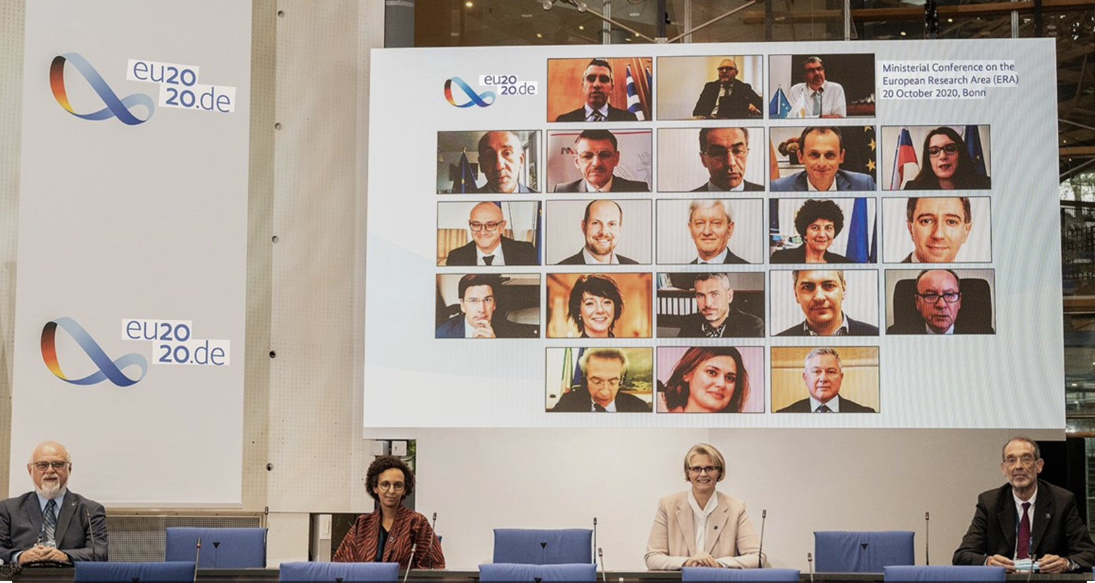
Bonn Declaration on Freedom of Scientific Research
Shared definition of FSR
Employ sound research methods
Right to disseminaton, including training and teaching
Informed by standards of academic disciplines
‘critical discourses are not disloyalty, but essential elements of a democratic society’
FSR as a ‘core value and principle’
Professional system of responsible self-regulation
Reference to EHEA monitoring system

Slide 6
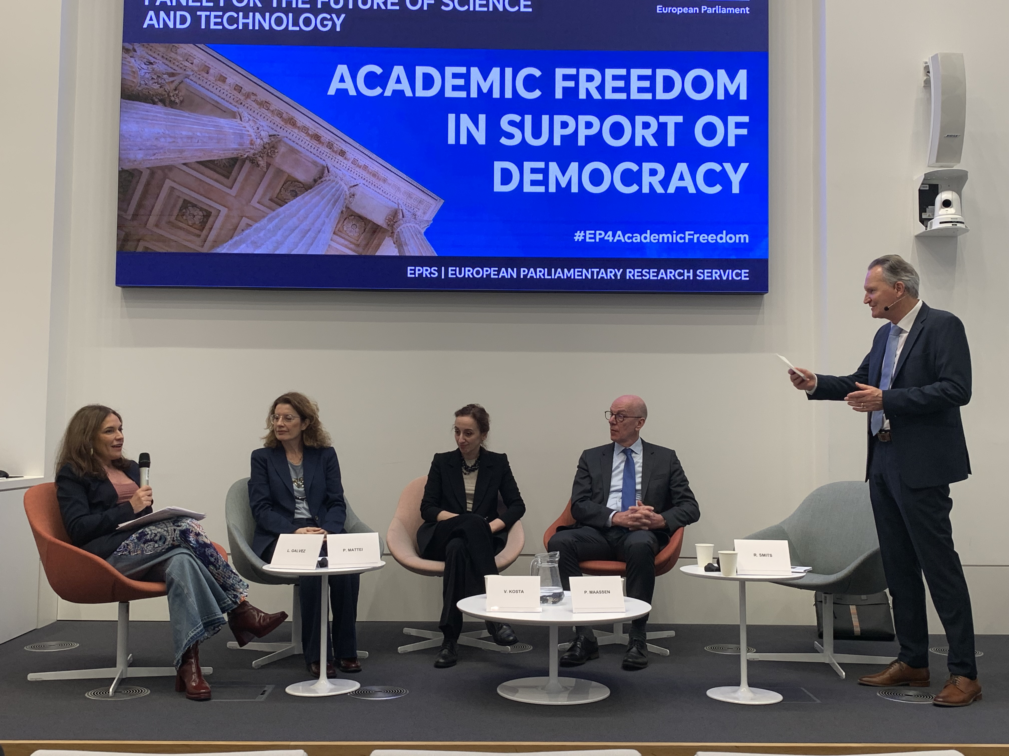
European Parliament
Annual AF Monitor since 2022
Own Initiative Report on Freedom of Scientific Research
Resolution January 2024 on Freedom of Scientific Research:
Precarity
Academic Self-Governance, including in scientific organisations
Recognises importance of adequate funding
Recommendations on Definition, Freedom, Rights, Institutional Obligations, and Government Obligations

Slide 7
Challenges and Opportunities
Alignment of initiatives – European Parliament, DG RTD, DG EAC, EHEA
Commission Mandate in research and education, Freedom of Scientific Research vs. Academic Freedom
How can the EU complement national laws/constitutional provisions and definitions?
How can an EU Law have ‘teeth’? (vs. Bonn Declaration)

Slide 8
Towards the ERA Act: The Current Context
China as a leading R&I competitor – knowledge security
The US
The political salience of R&I: Iran will ‘guard its modern technological capacities – from nano to bio to nuclear and missile – as their national capital and will guard it like their maritime land and air borders’
The rise of right-wing populism (France 2027, Poland, Germany, etc.)
Infringements in candidate member states: Georgia, Serbia
Academic Freedom within ERA Act as a basket/black box of priorities….

Slide 9
ERA Act: Issue areas
Alignment of R&I investments and policies
-Between the EU and Member States, and across Member States
R&D investment:
-Legally enforcing the 3% target
-Increasing the GDP spending target
Improving general conditions for research and researchers
ERA values
Free circulation of knowledge and researchers
Protecting freedom of scientific research
Gender equality dimension
Mobility of researchers and research careers
Open access
Aligning guidance on AI in research
Whistleblowing mechanism
Knowledge valorisation
European Research Infrastructure Consortia
What should be in a legal document?
What should be prioritised?
Research security
Common minimum standards

Slide 10
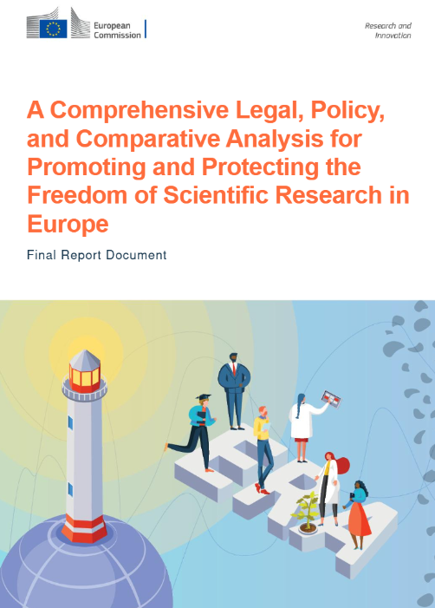
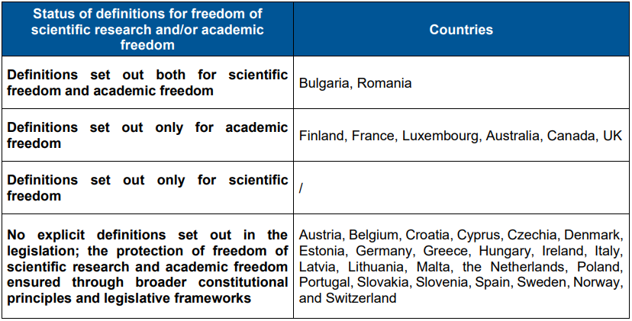
The protection of freedom of scientific research in the EU
1) Lack of explicit legal definitions
2) “While many countries provide de jure protections for researchers' rights, the effectiveness of these protections varies significantly. Some nations rely heavily on institutional policies and practices, which can lead to inconsistencies in the application of researchers' rights “

Slide 11

How to ensure an effective protection in the ERA Act?
EU legal framework with a common definition
Enforceability mechanisms
Fund conditionality?
European Ombudsperson?
Is fund conditionality appropriate and adequate?
Can an Ombudsperson alone ensure the protection of the freedom of scientific research?

Slide 12
Conclusions
Rich policy debate in Brussels
Key weakness: research vs. education mandate of the Commission
Added value: perhaps legal, but mainly political
New reference tool for ECJ
conditionality of funding
Naming and Shaming
Academic Freedom at a time of geopolitical fragmentation

