Slide 1
It is all about responsibility. Is It?
UNICA-GOAF Session 2
It starts from within: institutional frameworks of reference for academic freedom
Dean Kirsten Busch Nielsen
Faculty of Humanities
University of Copenhagen
King’s College London, 7. May 2026
Notes:
##-AccessibilityAssistant: Skip layout check-##

Slide 2
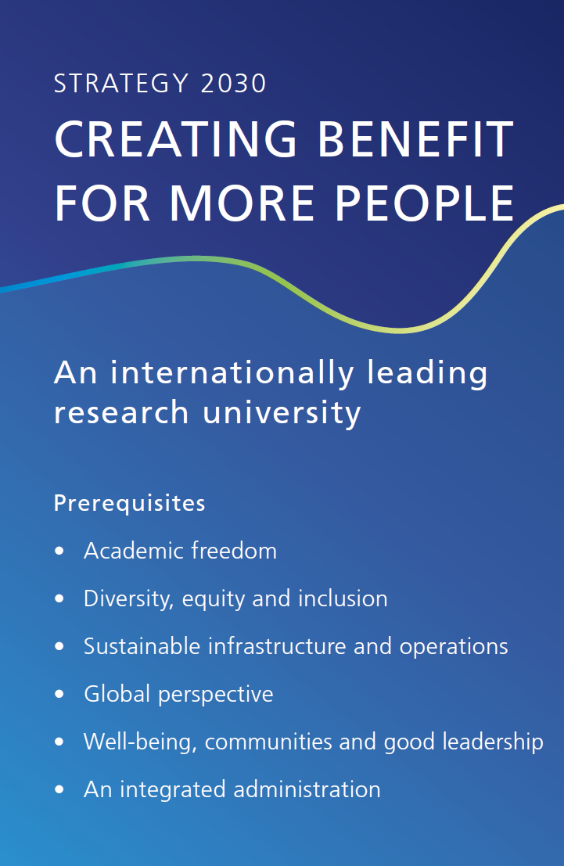
Academic freedom as value and responsibility at UCPH
Academic freedom at UCPH:
  a protected right and an operational responsibility exercised within a clear governance framework:
    the Danish University Act
    UCPH’s statutes
    personnel policy principle for all academic & administrative employees
    departmental management
    dedicated support units for funding, compliance, and external partnerships
  first enabler and part of the realization of UCPH’s Strategy2030

Slide 3
Academic freedom effort at UCPH – 3 work tracks
Initiatives under the UCPH academic freedom effort are organized in 3 separate but interconnected tracks A-B-C to support & strengthen academic freedom at UCPH
  track A: academic freedom - research and innovation
    incl. roles & responsibilities of individual researchers & UCPH as institution
  track B: academic freedom - early career researchers & UCPH PhD program
    incl. roles & responsibilities of Ph.D. & postdocs, their supervisors & PIs
  track C: academic freedom - teaching and learning
    incl. roles & responsibilities of students & lecturers
Track A-B-C working committees will develop & implement initiatives & final outputs in collaboration & co-creation between UCPH students, staff & management in 2025-2027

Slide 4
Academic freedom effort at UCPH – aim and purpose
Aim - a final output on academic freedom at UCPH,
which is clarifying in principle and in practice
for UCPH’s students, staff and management, and UCPH as institution
Purpose - to make the implicit value academic freedom explicit at UCPH
        the principled level is directed both internally and externally
        - this is how UCPH stands on academic freedom
        the practical perspective is primarily directed internally
        - this is how UCPH works with academic freedom

Slide 5
Academic freedom at UCPH – researcher responsibility
At UCPH, individual researchers safeguard academic freedom by:
  exercising independent scholarly judgment on questions, methods, analysis, results, and communication
  upholding research integrity and ethical standards, and disclosing conflicts of interest
  engaging in responsible dissemination, distinguishing between scholarly evidence and personal opinion, in research, research-based education and public engagement
  shaping norms through hiring, peer review, supervision, and promotion in collective academic communities such as research groups, departments, and faculties
  using UCPH support structures and UCPH governance norms to prevent undue influence from external funding, partnerships, or administrative pressures over research processes or results while respecting UCPH’s statutory obligations

Slide 6
Academic freedom at UCPH – institutional responsibility
UCPH is a state-financed, self-governing institution under the Danish state, within the public administration, under supervision of the Minister for Higher Education & Science
Academic freedom at UCPH is:
  bestowed upon the university in The University Act § 2, stk. 2. The university must safeguard the academic freedom of the university and the individual researcher
  bestowed by the institution upon researchers. The academic staff is free to conduct research within the university's strategic research framework during the time when they are not performing allocated tasks
  protected by university statutes as an institutional norm embedded within the managerial structure
  a key concept in the societal contract between society and university

