Slide 1
Professor Rachel A Mills, CBE
From Principles to Practice: King’s Framework for Academic Freedom
7 May 2026

Slide 2
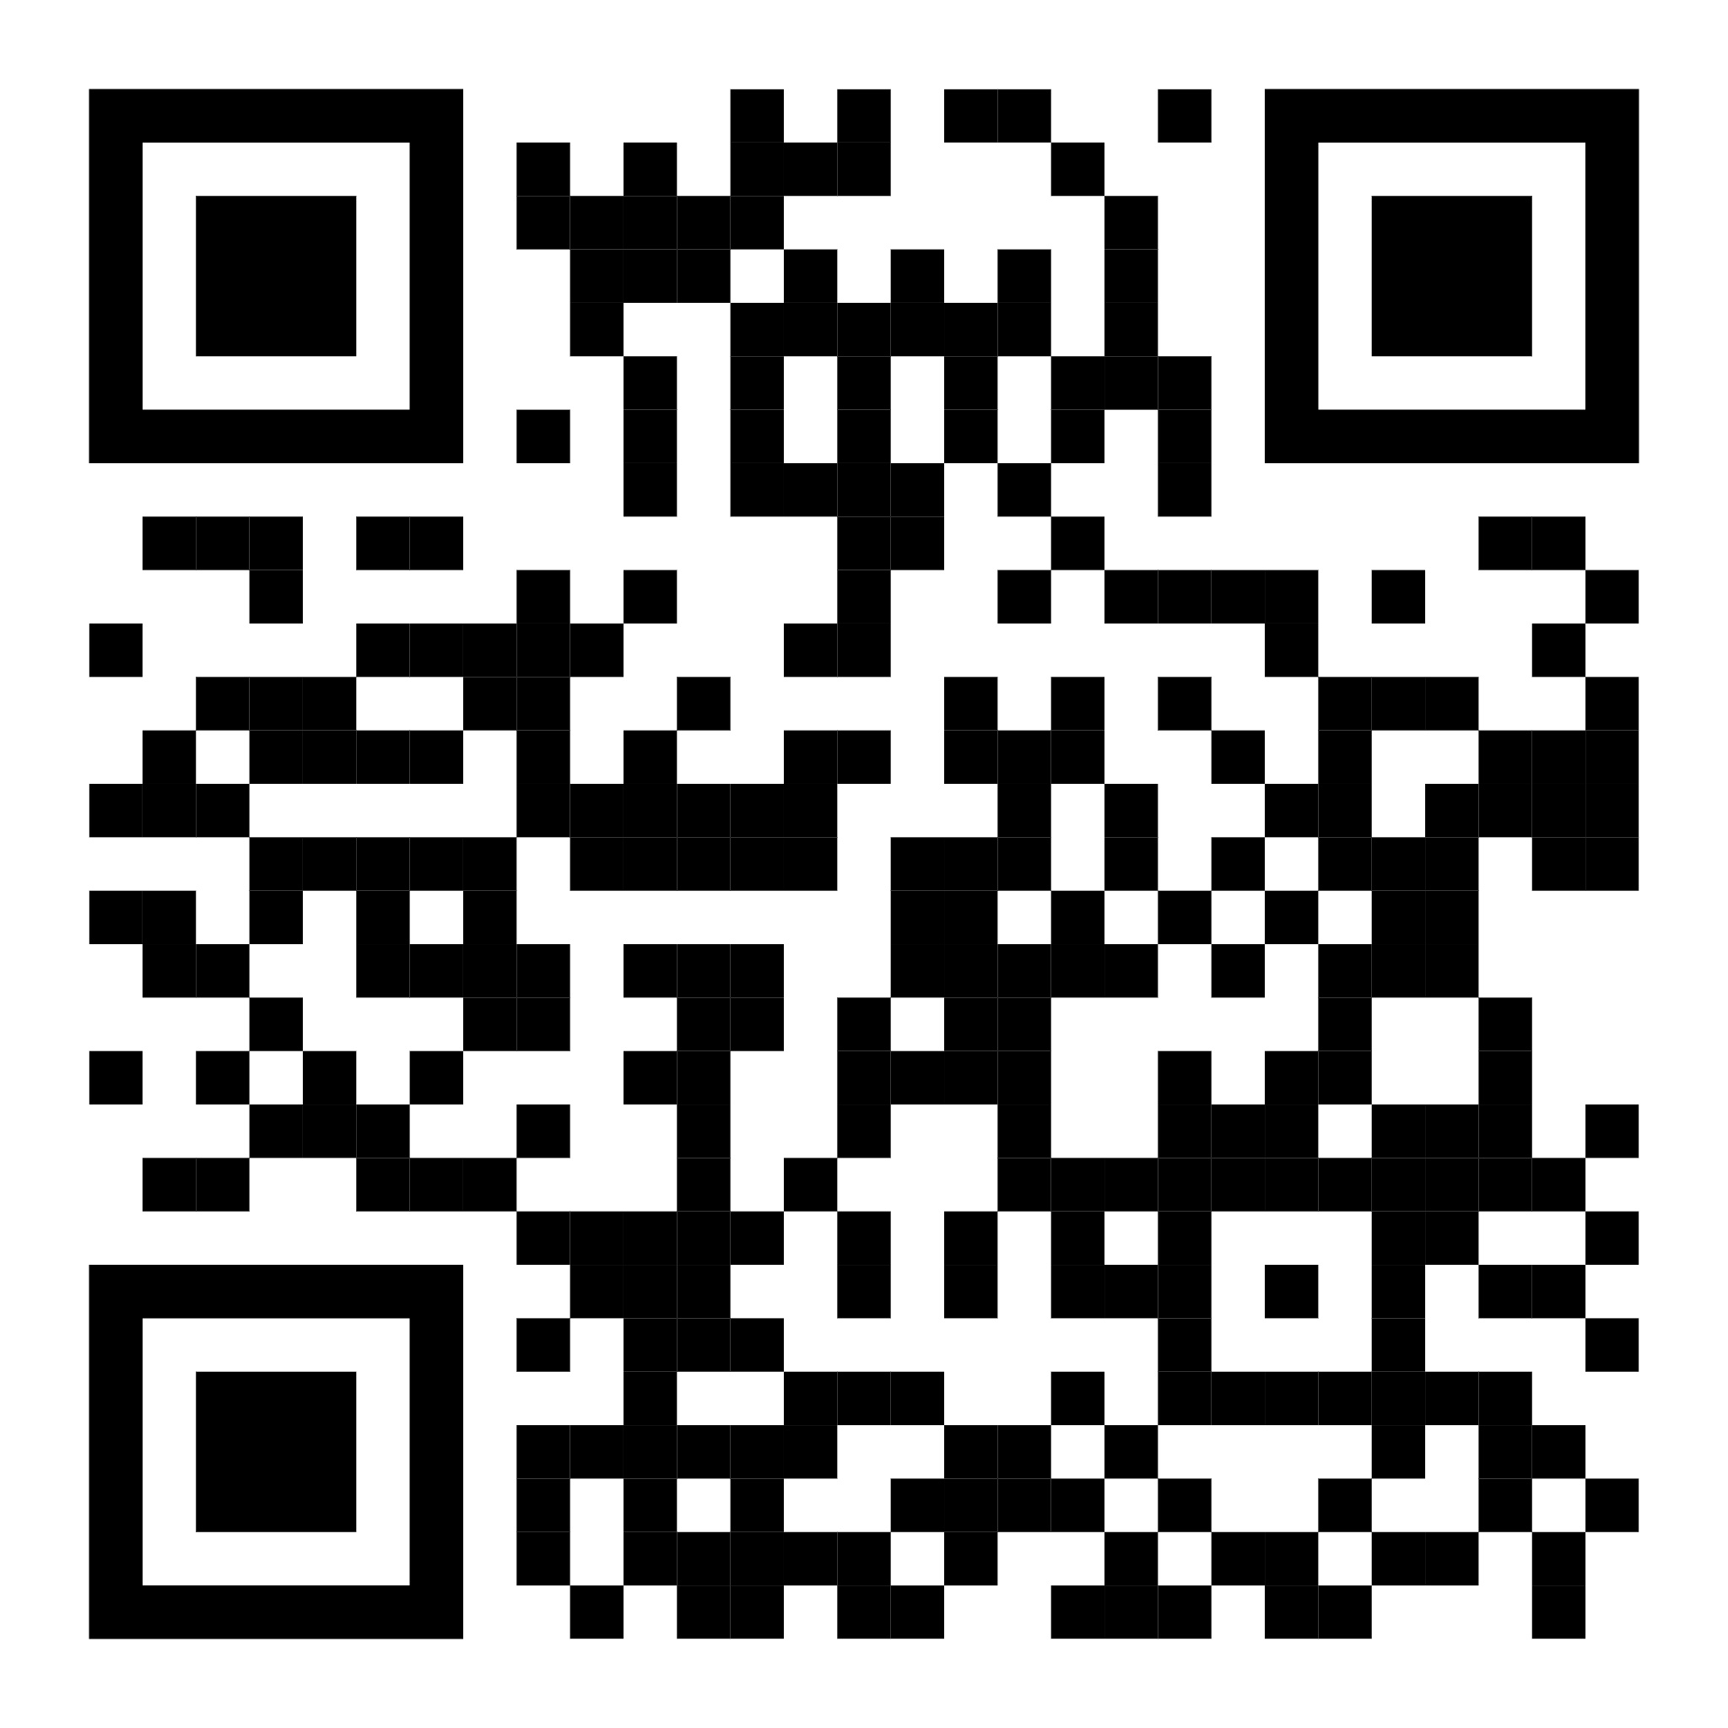
UK context: 2023 Higher Education (Freedom of Speech) Act came into effect 1 Aug 2025
King’s Charter and Statutes provide autonomous, research‑intensive mission; the 2025 Code of Practice spells out protections of academic freedom and freedom of expression within that constitutional framework.
https://www.kcl.ac.uk/assets/policyzone/governancelegal/academic-freedom-freedom-of-expression.pdf

Slide 3
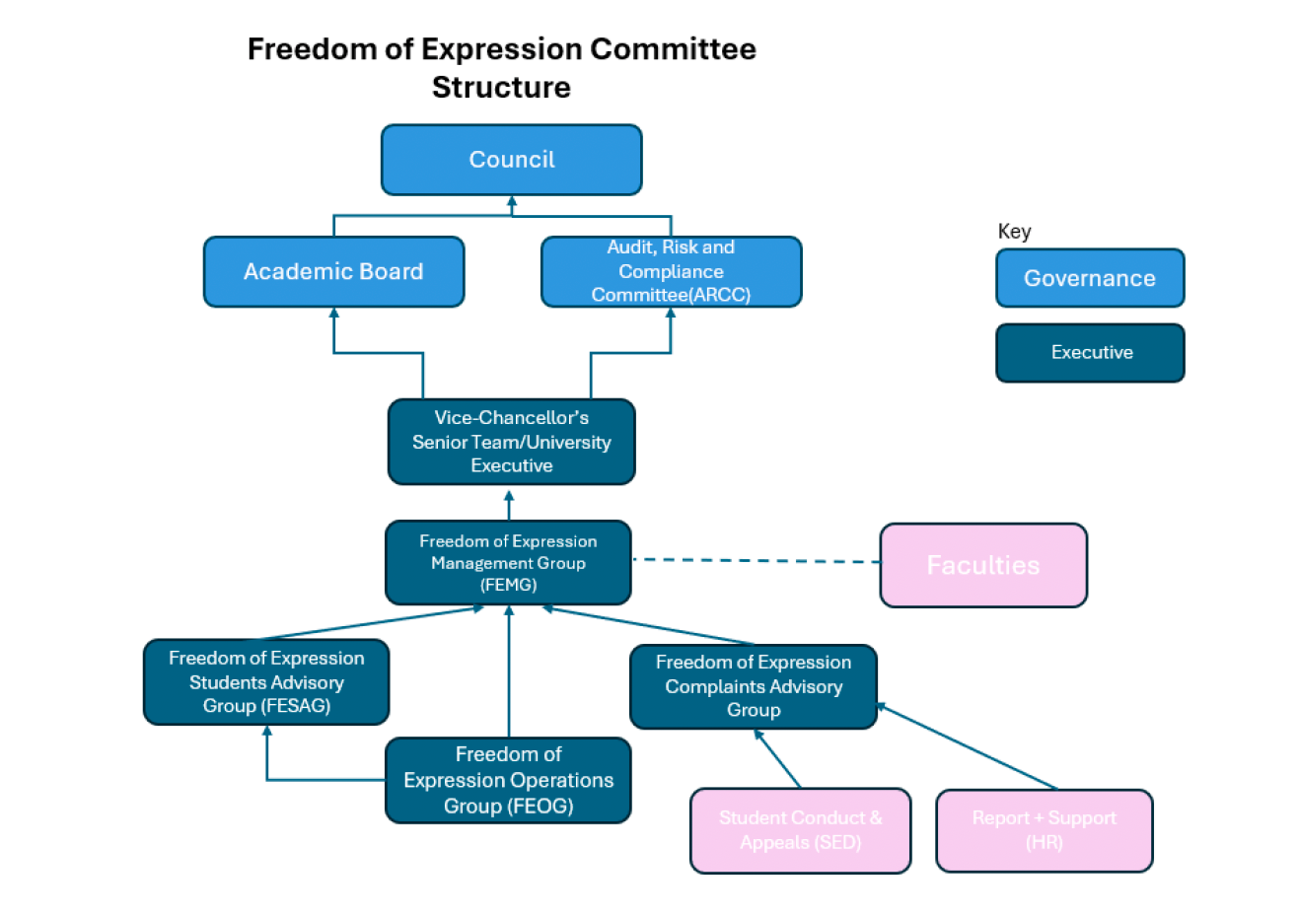
Our Governance Structure

Slide 4
How is it going?

