Slide 1


Academic Freedom Through the Eyes of Students
EHEA Framework
Lana Par
President of ESU

Slide 2

What is ESU?

Slide 3
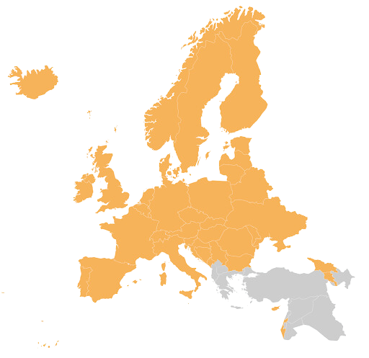





43 National Unions of Students (NUS) from 40 countries
20 million students across Europe
Representing & promoting educational, social, economic and cultural interests
Towards the European Union, the Bologna Follow-Up Group, the Council of Europe and UNESCO

Slide 4
EHEA Framework - mission of HE
Learning and Teaching (First Mission): Providing high-quality education, developing curricula, and fostering student-centred learning to equip students with the skills, knowledge, and competencies needed for their professional lives and for active citizenship.
Research and Innovation (Second Mission): Conducting rigorous scientific research and development that fosters innovation, creativity, and the advancement of knowledge, serving as the foundation for teaching.
Service to Society / Community Engagement (Third Mission): Transferring knowledge, technology, and innovation to non-academic environments to address social, economic, and cultural challenges, often referred to as outreach or university extension.

Slide 5
Fundamental values in EHEA
Tirana Ministerial Conference (2024), the ministers adopted a Statement defining the fundamental values, reflecting years of work by the BFUG and consultations with stakeholders, and providing a common and conceptual understanding of the fundamental values. The Tirana Communiqué not only defines the values, but also the expectations regarding the implementation, monitoring and mutual reinforcement of these values in national systems and institutions.
The document adopted at the Tirana underlines that the core values of the EHEA form a coherent and interconnected whole, which cannot be understood or implemented in a piecemeal manner. Respect for one of these values is closely linked to the achievement of the others, and the weakening of one of the dimensions affects the balance of the entire value framework. In this context, the responsibility for promoting and protecting core values lies with all stakeholders, including public authorities, higher education institutions, students, academic and administrative staff and civil society.

Slide 6
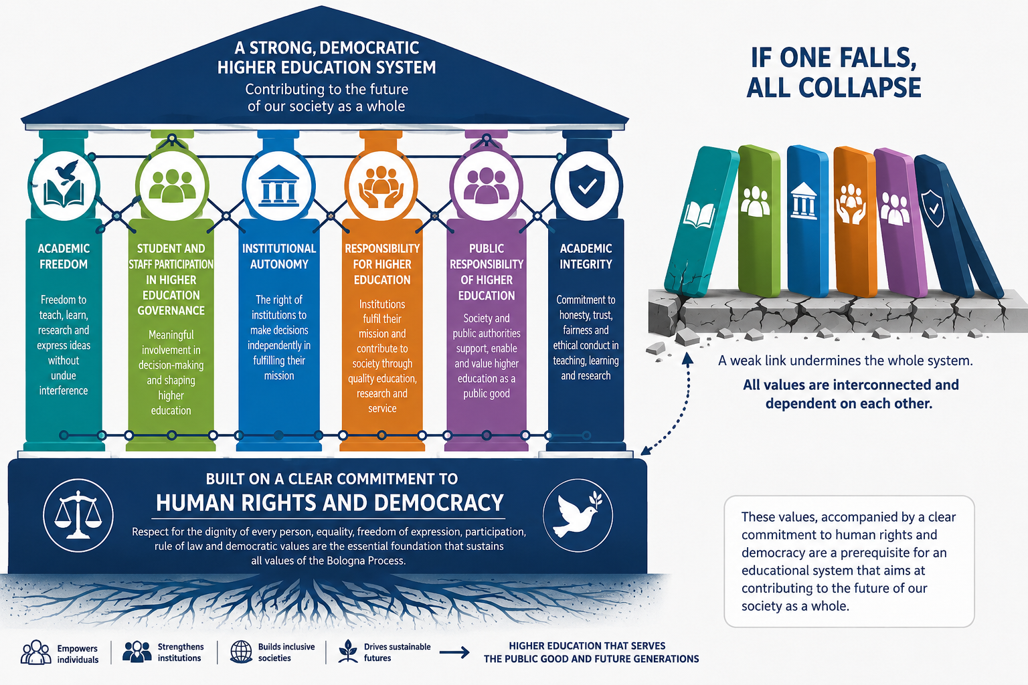

Slide 7
Academic Freedom
Academic freedom is a universal value rooted in the pursuit of knowledge and truth.
Academic freedom designates the freedom of the academic community - including academic staff and students - in respect of research, teaching and learning and, more broadly, the dissemination of research and teaching outcomes both within and outside the higher education sector.
In essence the concept ensures that the academic community may engage in research, teaching, learning and communication in society without fear of reprisal
Academic freedom must be framed by rigorous scientific and professional standards, respect for the rights of others, ethical conduct and the awareness of the impact of research on humans and their environment
Academic freedom can be understood to comprise the freedom to learn, to teach and to research, with each of these freedoms entailing the freedom to think, to question, and to share ideas, both inside and outside the higher education sector

Slide 8
Academic Freedom
The freedom to research
The freedom to research includes the right, consistent with professional standards of the respective discipline, to determine:
what shall (or shall not) be researched;
how it shall be researched;
who shall research,
with whom
what purpose research shall be pursued;
the methods by which, and avenues through which, research findings shall be disseminated.

Slide 9
Academic Freedom
The freedom to teach
WHAT?
Academic staff also exercise a strong responsibility in setting the curriculum and programme components, and developing the teaching methods employed.
It is essential to ensure that academic staff benefit from sufficiently secure employment conditions to be able to exercise academic freedom.
Academic staff should never suffer threats, dismissal, or other sanctions in relation to the content of their research, teaching or stated professional views.
WHO?
Public authorities have the responsibility to ensure that relevant higher education programmes are offered to citizens, while autonomous higher education institutions assume a large responsibility for research underpinning programmes, and for how programmes are taught.
can only be realised concretely in combination with public and social responsibility and institutional autonomy.

Slide 10
Academic Freedom
Values are inter-connected, and the freedom to teach also raises the question of who is to be taught and is thus intimately linked to the freedom to learn. In turn these values relate to equitable access, with a range of issues on criteria and conditions for access to higher education needing to be addressed through societal dialogue and administrative procedures.
Similarly questions also need to be asked about who is doing the teaching and research, and the kind of decision making process in place for academic staff recruitment and retention.

Slide 11
Academic Freedom
The freedom to learn is rarely recognized in constitutions or higher education laws, whereas the freedom of science and teaching is more commonly protected. This creates a legal hierarchy that disadvantages students. To address this imbalance, the freedom to learn and students’ rights to participate in higher education governance must be equally enshrined in constitutional and other relevant legal frameworks.

Slide 12
Academic Freedom
For students, academic freedom:
Guarantees freedom to learn, question, and develop independent thinking
Creates safe learning environments, free from fear, censorship, or retaliation
Ensures access to diverse ideas and perspectives, essential for critical learning
Protects the quality of teaching, grounded in academic standards rather than external pressure
Empowers student participation, allowing students to express views on institutional policies
Strengthens democratic citizenship, by fostering open debate and responsibility

Slide 13
BWSE 2024
15 out of 36 NUSs answered that they are not involved in any discussion on academic freedom with public authorities, pointing towards a lack regarding the continuous promotion and protection of academic freedom in the EHEA
A worrying 14 out of 36 NUSs report that there have been incidents where students have been subject to threats or consequences due to their student activism in recent years. As responsible for these incidents NUSs reported equally often that public authorities, higher education institutions’s leadership and academic and administrative staff were the aggressors

Slide 14
Lately, the European Students’ Union has seen the erosion of academic freedom as one of the top priorities for National Unions of Students (together with the overall erosion of democracy)
ESU has also analyzed the latest findings of the EP Academic Freedom Monitor and the data in the annual Academic Freedom Index (March, 2026)
What are we worried about?

Slide 15

What did we find out?
Academic freedom is not collapsing overnight, but is steadily eroding
EU members states that declined in the Academic Freedom Index:
15 out of 27, over the past year
24 out of 27, over the past 5 years
25 out of 27, over the past decade

Slide 16
The commercialization and commodification of higher education
Political pressure, the growth of polarisation and the overall erosion of democracies
Anti-intellectualism and societal pressure
Security policies and foreign interference
Fundamental values of higher education placed at risk
Main challenges, from the perspective of students

Slide 17
Student Protests Monitoring
September – November 2025
From September to mid November 2025, we tracked 25 distinct student protests across the European Higher Education Area, with some starting even in January 2024.
They stretch across 13 countries: Armenia, Belgium, France, Germany, Greece, Ireland, Italy, the Netherlands, Romania, Serbia, Spain, Switzerland and Türkiye.
November 2025 – January 2026
7 of 13 protests started during the reporting window, indicating an ongoing “new wave” rather than only continuation of older cycles
1 case began already in 2024 and continued into this period
3 cases began in early 2026 and fall within the window

Slide 18
What drove students to act
Democracy and governance
6 cases explicitly reference Political Governance/Democracy
Most often paired with Government Transparency, as seen in 6 cases
4 add Corruption & Nepotism as a cause
Resignation of Government Officials appears in 3 actions
End of Authoritarian Practices is also noted in 2 actions
Higher Education Institutions
2 cases request Higher Education Funding Increase
A call for more Transparency in Universities also appears throughout Material conditions and access
3 protests involve Economic & Living Conditions
5 mention Access & Safety in Education
3 reference Security & Policing
6 protests include Human Rights & International Solidarity
3 cases involved Divestment from Conflict States

Slide 19



individual exceptions

Slide 20
Can the freedoms to research and freedom to teach even exist without freedom to learn?
Who will teach and who will do the research?

Slide 21









Follow us !
@Europeanstudents
@esu.online
@EuropeanStudentsUnion
www.esu-online.org
@esuonline.bsky.social
@ESUtwt

