Slide 1
ESN Galaxy
European Campus Café, Brussels 27th January

Slide 2
AGENDA
ESN Galaxy| European Campus Café

Slide 3
Agenda
About us
ESN, UNICA & Youth Agora
ESN Satellite
ESN Galaxy
National level
Local level
European Campus and Galaxy

Slide 4
About us
ESN Galaxy| European Campus Café

Slide 6
What is ESN?
Erasmus Student Network
34 countries
358 sections
12.000 members
Aims:
offering services to exchange students
developing and supporting student exchange

Slide 7
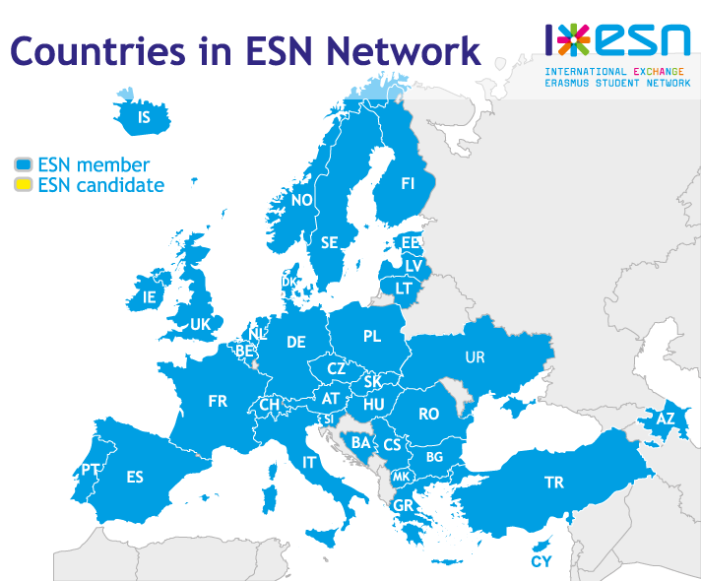

Slide 8
ESN, UNICA & youth agora
ESN Galaxy| European Campus Café

Slide 9
ESN & UNICA
Cooperation in different projects
European Campus
ExchangeAbility
ESN & Youth Agora
Former ESN members
First versions of ESN Galaxy, Satellite
Continuous cooperation

Slide 10
ESN satellite
ESN Galaxy| European Campus Café

Slide 11
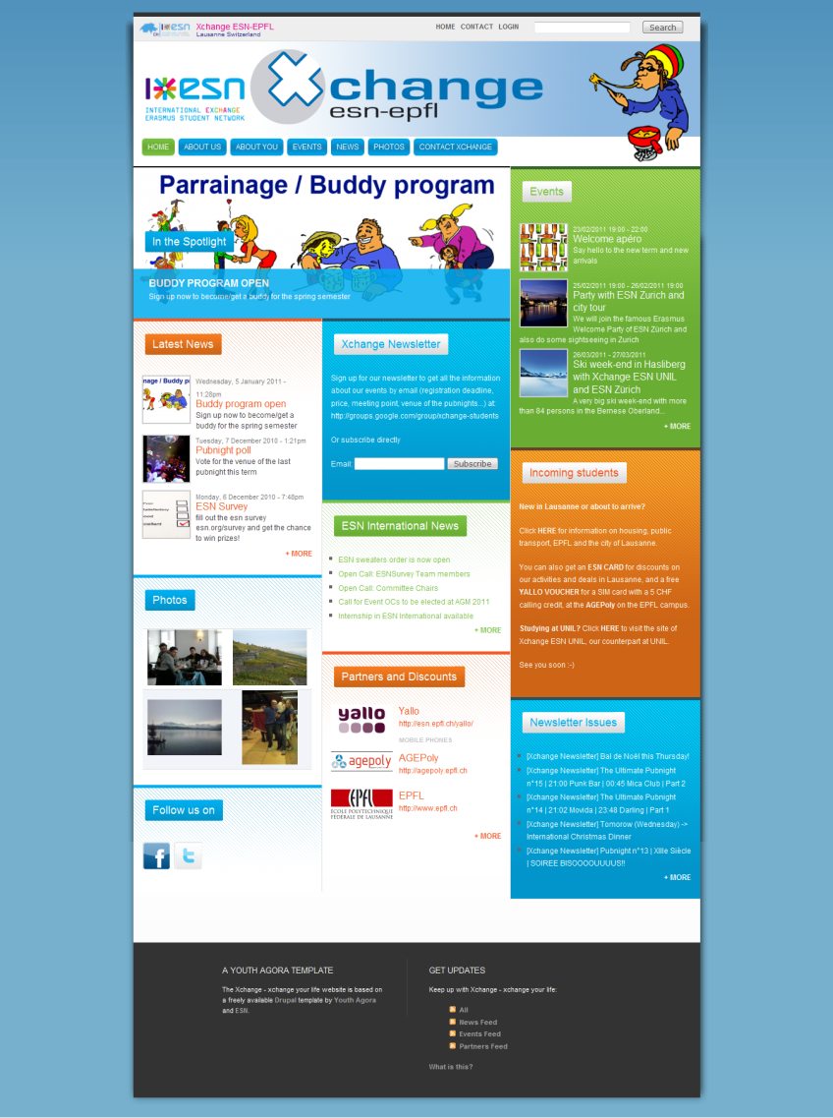
ESN Satellite
Template website for local sections
Easy to configure
Corporate identity

Slide 12
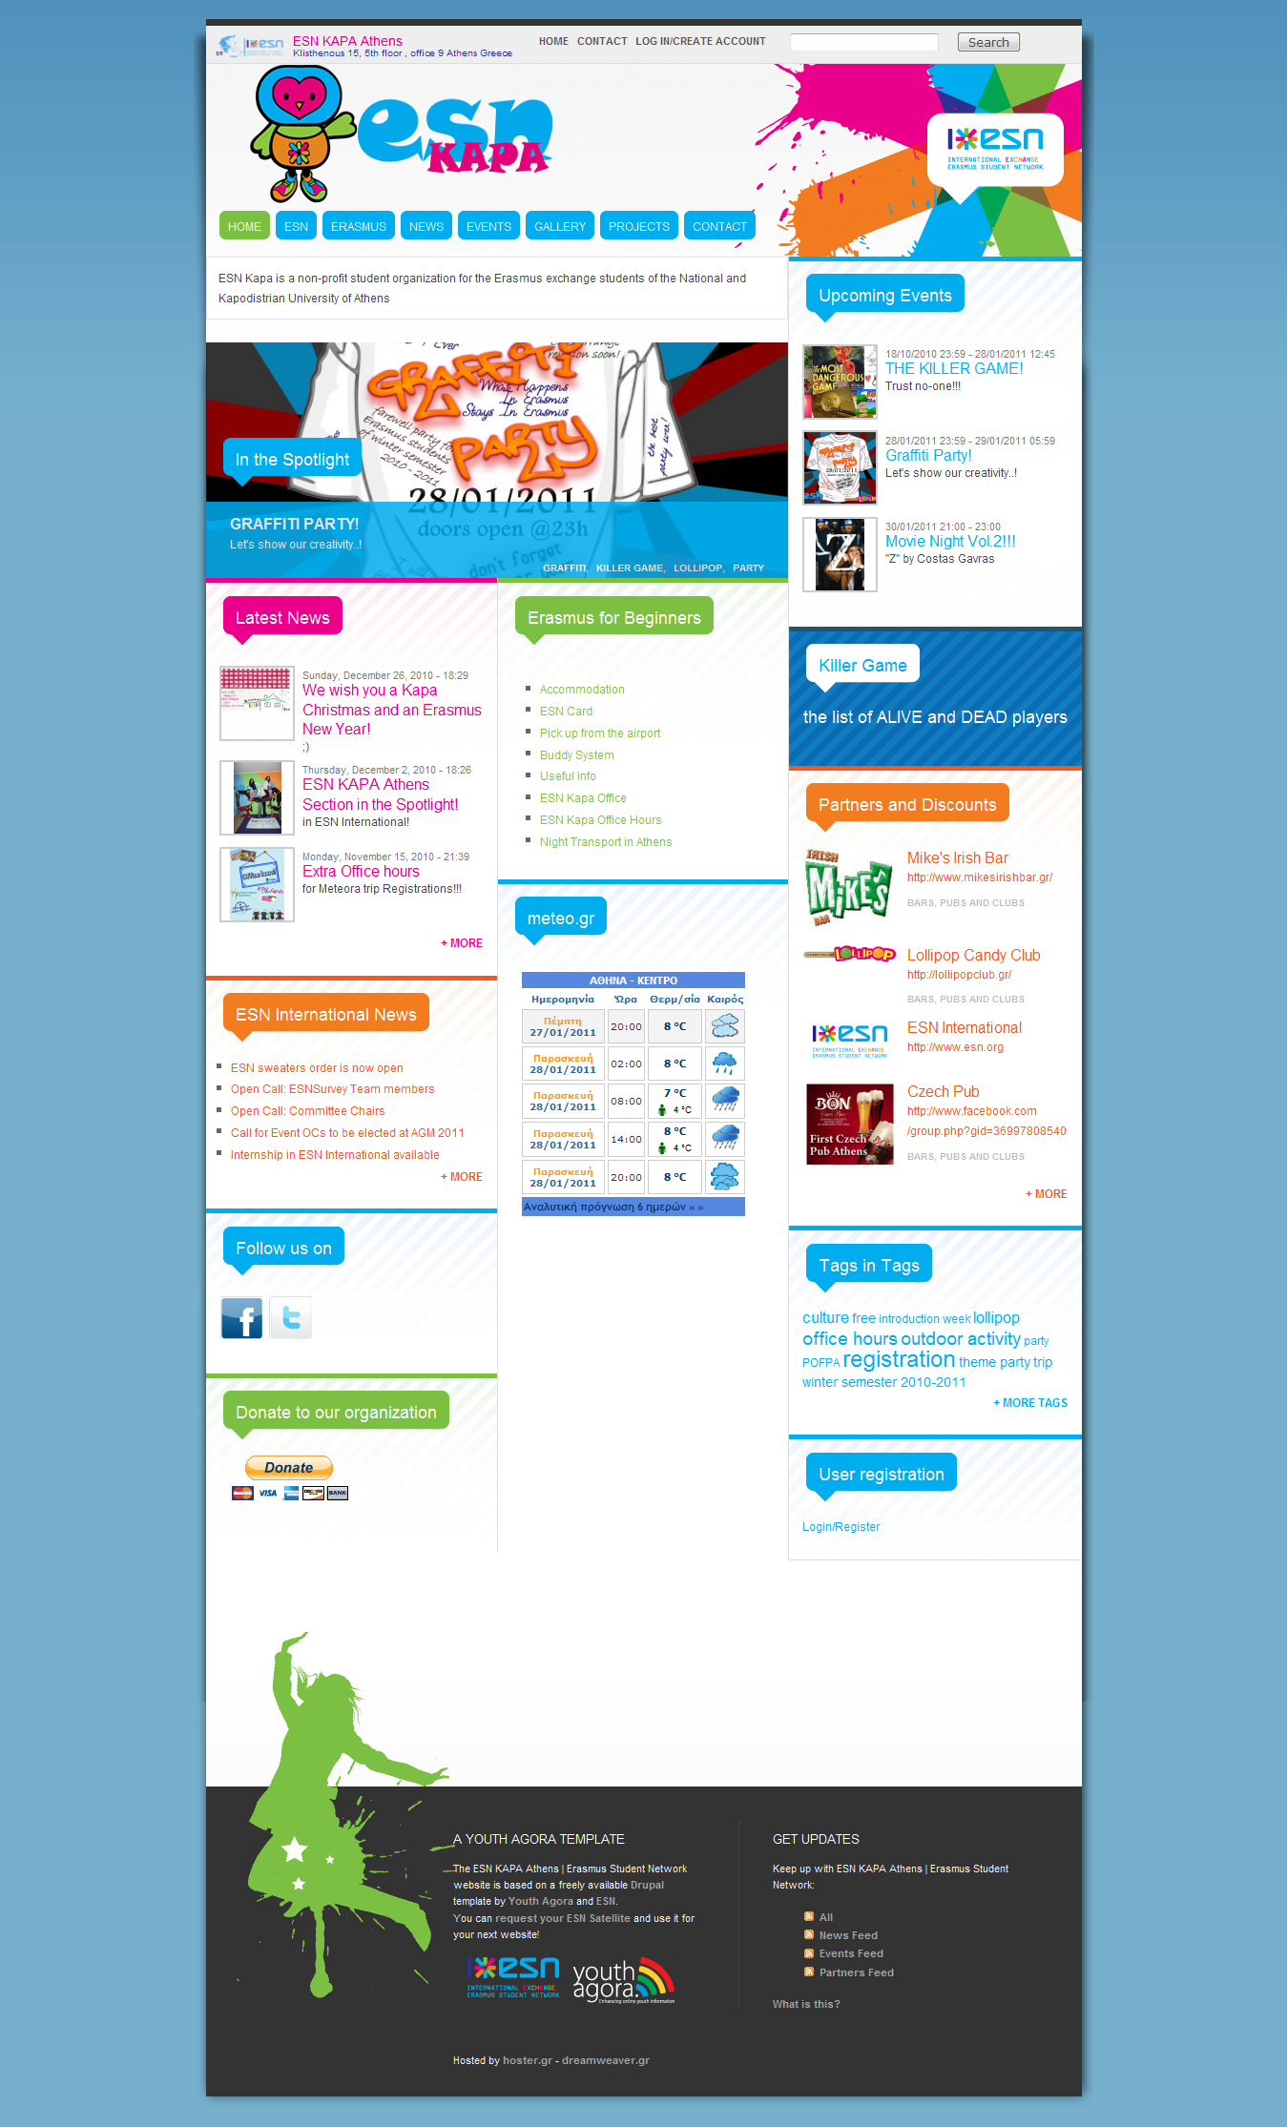

Slide 13
ESN Galaxy
ESN Galaxy| European Campus Café

Slide 14
ESN Galaxy
Centralized system of the whole ESN network
Feed Aggregator
Local and National level
News
Events
Partners
Intranet

Slide 15
ESN Galaxy
Country view:
Contact details
National events & news
List of Local sections
Active members on the national level
Alumni

Slide 17
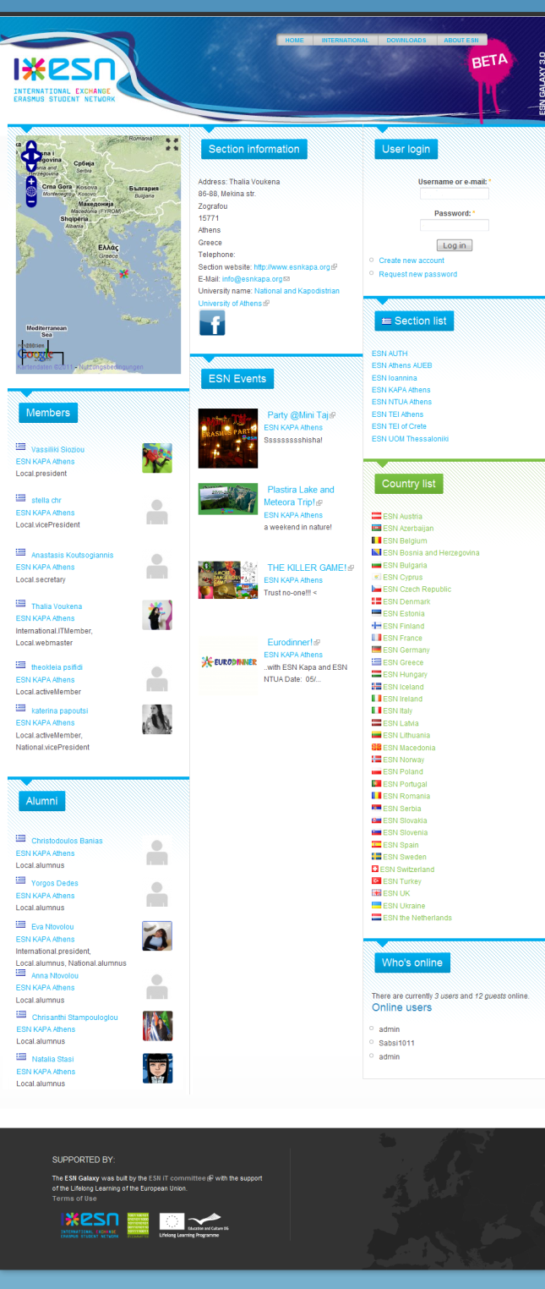
ESN Galaxy: Sections
Section view:
Contact details
Local events & news
Local Board Members
Active members of the sections
Alumni

Slide 18
ESN Galaxy: new design
To be implemented by April 2011

Slide 19
ESN Galaxy: new design

Slide 20
ESN Galaxy and european campus
ESN Galaxy| European Campus Café

Slide 21
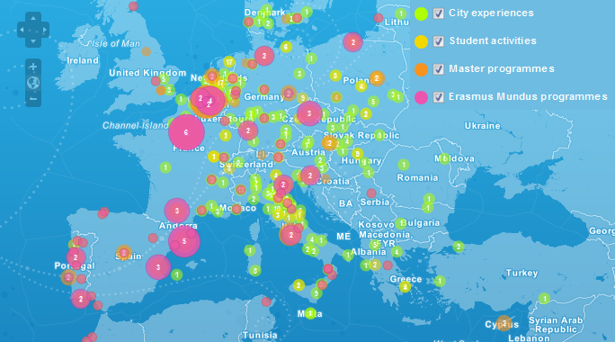
European Campus
European map: share your experience!
Feeds from different websites:
ESN
Erasmusu
Master programmes
Erasmus mundus

Slide 22
Integration with ESN Galaxy
Development by ESN Webteam
Fully integrated with the organization’s websites
Receives from ESN Sections and ESN International:
News
Events
Local Events
ESN Galaxy
European Campus

Slide 23
TIME FOR QUESTIONS
ESN Galaxy| European Campus Café

Slide 24
THANK YOU FOR Your ATTENTION

