Slide 1
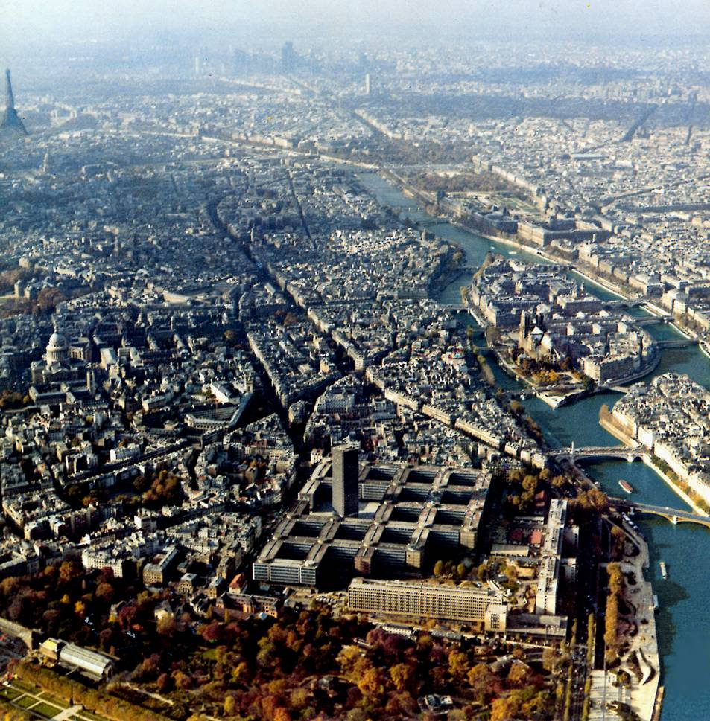
AGENDA General Assembly
Paris, November 6, 2009

Slide 2
AGENDA General Assembly
Welcome address by the Rector of the Université Pierre et Marie Curie, Prof. Jean Charles Pomerol
Opening of the General Assembly by the President, Prof. Stavros A. Zenios.
Adoption of the Agenda
Adoption of the Minutes of the Prague General Assembly, October 17, 2008
President’s Report 2008-2009
Presentation of Universidade de Lisboa, new member since 2009
UNICA EC Projects, Arthur Mettinger

Slide 3
6. UNICA Policies
Membership Criteria for the UNICA Network
Student Conference 2010, Raimondo Cagiano de Azevedo & Luciano Saso
Working Group on Research Evaluation in Higher Education, Philippe Vincke & Veronique Halloin
UNICA Observatory in Administrative Excellence, Gregory Prastracos

Slide 4
7. Financial Status
Approval of the 2008 accounts
Auditor’s Report 2008
2009 financial situation (up to October 15, 2009)

Slide 5
8. Elections Steering Committee
Presentation of the candidates
Elections
---Coffee Break---
Announcement of the results

Slide 6
AGENDA General Assembly
9. Membership fee 2010
10. Work Programme 2009-2010
11. Approval of the Budget 2010

Slide 7
12. Next Meetings
IROs’ Meeting, Humboldt University, May 5-7, 2010
Rectors’ Seminar 2010, Tallinn University, May-June 2010
UNICA General Assembly 2010
&
Celebration UNICA 20th Anniversary
University of Vienna, October 21- 23

Slide 8
AGENDA General Assembly
Thank you for your contribution!
The meeting is closed

