Slide 1
UNICA EC PROJECTS

Slide 2
PROJECTS
Information Project on Higher Education Reform III: Lisbon Strategy and Bologna Process
Tempus Joint European Project: PRIUM PRomoting a Model of Integrated University in the FYR of Macedonia
Leonardo da Vinci: Be-TWIN, Testing a Joint ECVET-ECTS Implementation
Erasmus Mundus ‘Enhancing Overseas Student Mobility: European Campus
UNICA - EC PROJECTS

Slide 3
HE Reform II Renewal
Contract Period: Dec 2008 – Dec 2009
Budget: € 277,000
(UNICA € 54,350 staff + other)
Consortium members: UNICA-BES
Main objectives:
Assisting National Bologna Experts through materials, case studies and two training seminars.
Virtual Community of Bologna Experts.
UNICA - EC PROJECTS

Slide 4
Seminars
‘Making Mobility Happen’
University of Rome
La Sapienza
30-31 March 2009
150 participants
www.rome.bolognaexperts.net
‘Competences for the Future’
University of Warsaw
23-24 October 2009
160 participants
www.warsaw2009.bolognaexperts.net

Slide 5
HE Reform II: Seminars

Slide 6
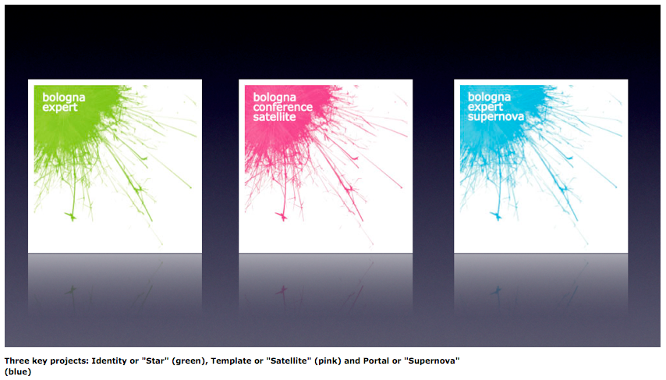
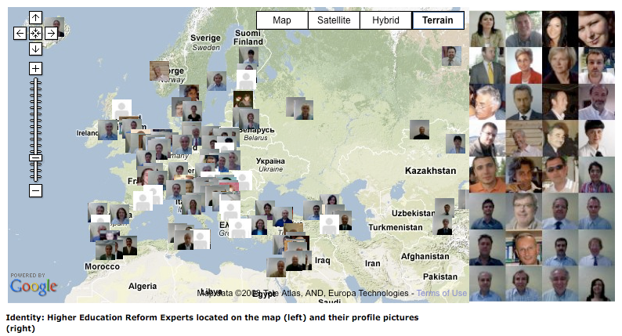
Virtual Community
More than 400 HE
Experts registered
www.bolognaexperts.net
UNICA - EC PROJECTS

Slide 7
Discussion Papers
Erasmus Mobility beyond 2013: Some Observations and Suggestions, by Guy Haug
Mobility and the Labour Market, by Jannecke Wiers Jenssen
Students Bologna Experts Contribution to 'Making Mobility Happen', by Rossella Iraci Capuccinello
Work Placements as Key Element in the Preparation for Employability, by Els van der Werf
Future Skill Needs in Europe: The Stakeholders Point of View, by Juan Menéndez-Valdés
More papers will be published before the end of this year
http://portal.bolognaexperts.net/

Slide 8
What’s next?
New proposal presented by UNICA at the end of Oct.
If approved:
5 seminars for Bologna & HEREs in Europe
5 regional seminars in Tempus countries
20 missions of experts from different areas to Tempus countries
UNICA will look for hosting universities and experts
ANY CANDIDATE?
Please contact the Secretariat: project@unica-network.eu

Slide 9
TEMPUS JEP - PRIUM
Contract Period: 01.10. 2007 – 15.11. 2009
Budget: € 209,045
(UNICA € 13,215 staff + other)
Consortium members: UNICA (coordinator)
- Ss. Cyril & Methodius University in Skopje
- St. Kliment Ohridski University in Bitola
- University of Vienna
- Vrije Universiteit Brussel
- Brussels Education Services
Main objective: Promoting an Integrated Model of University in the FYR of Macedonia

Slide 10
Fields of Action
University Governance and Financing Reform
Strengthening of Strategic Management Capacities
Strengthening of Central University Services
Final event: The Modernization Agenda for Universities
Vienna, 12 November 2009
UNICA - EC PROJECTS

Slide 11
Main PRIUM Events

Slide 12
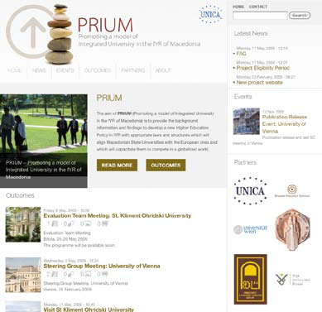
PRIUM Publications
PRIUM Notebook
PRIUM Publication
(end of November)
PRIUM Website
www.prium.unica-network.eu
UNICA - EC PROJECTS

Slide 13
Be-TWIN
Coordinator Chambre de Commerce de Paris Ile-de-France
UNICA coordinates WP 2 (Methodology) and participates in WP 6 (Dissemination)
Budget : 566,270€ (10,553€ staff)
Objectives:
Testing a Joint ECVET-ECTS Implementation
Creating translation tools for reaching common goals of transparency, mobility and recognition.

Slide 14
Erasmus Mundus: European Campus
Contract Period:
Nov. 2008 – Nov. 2010
Budget: € 262,800 (44,000€ staff)
Partners:
Pilot Group:
www.europeancampus.eu

Slide 15
Main Objectives
Enhancing attractivenesss for overseas students
Improving information provision
Promoting standarization in Higher Education
Strengthening Cooperation between students & universities

Slide 17
EC Projects: Outcomes for UNICA
Increase visibility of the Network;
Involvement of UNICA experts and universities;
Driving force in the development of the Bologna Process;
Face-to-face relations with the European Commission and lobbying;
Integration of universities from Central and Eastern Europe into the EHEA;
Support members in co-operative projects;
UNICA staff for the projects’ management.

Slide 18
THANK YOU FOR YOUR ATTENTION!
UNICA - EC PROJECTS

